Slide 1
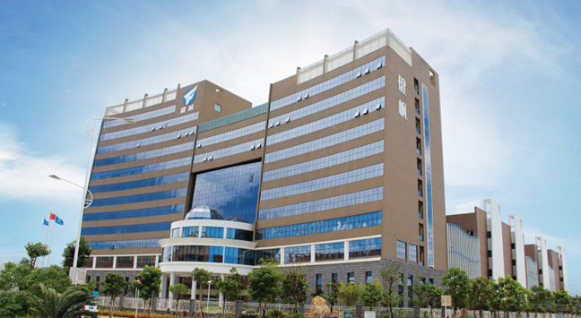
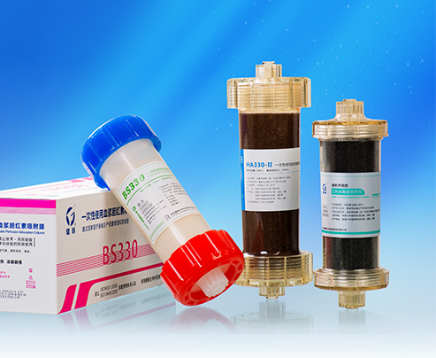
DPMAS for Liver Failure
Notes:
Welcome to Jafron Online Video Course. Today, we will talk about a Liver support system DPMAS for liver disease.

Slide 2
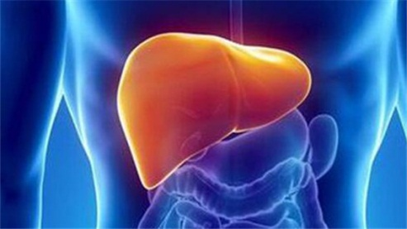
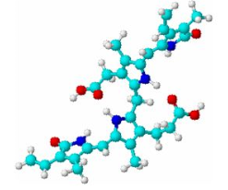
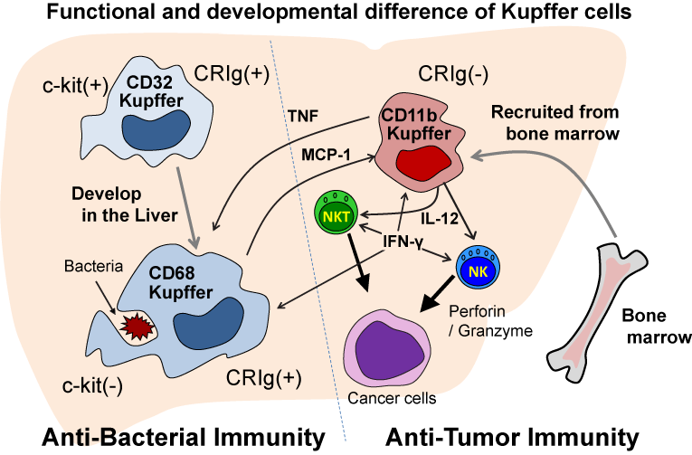
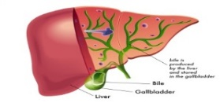
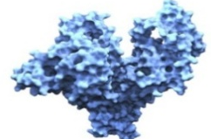
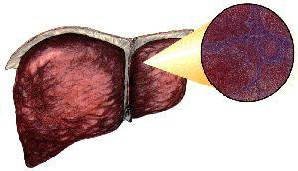
Liver Failure
Metabolization
Storage
Immunology
Synthesis
Detoxification
Definition:
Liver failure is the inability of the liver to perform its normal synthetic and metabolic function as part of normal physiology.
Notes:
Metabolization of carbohydrates, proteins and bilirubin
Immunological function is related with kupffer cells
Synthesis of angiotensinogen, albumin, Bile and coagulants
Storage of Vitamin and mineral
Detoxification of Toxins and Drugs

Slide 3
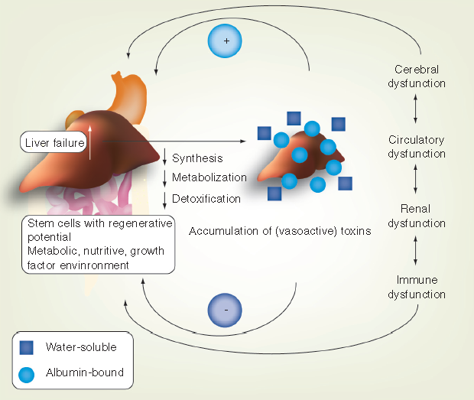
The toxin hypothesis
The failing liver results in the accumulation of a variety of toxins, which are presumed cause of end-organ dysfunction.
The combined actions of accumulated toxins and end-organ dysfunction further aggravate liver injury and incapacitate the regenerative environment.
Laleman W, Verbeke L, Meersseman P, et al. Acute-on-chronic liver failure: current concepts on definition, pathogenesis, clinical manifestations and potential therapeutic interventions.[J]. Expert Review of Gastroenterology & Hepatology, 2011, 5(4):523.
Notes:
Liver failure lead to function decline of liver synthesis, metabolization, and detoxification.
These function decline accompany with accumulation of toxins, result in complications such as cerebral dysfunction, circulatory dysfunction, renal dysfunction, immune dysfunction…
The complications react on liver function, aggravate liver dysfunction, and destroy regenerative environment of liver cells.
Therefore it is a vicious circle. Early and efficient treatment is always necessary for liver failure patients.

Slide 4
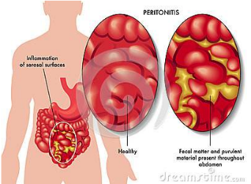
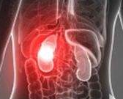
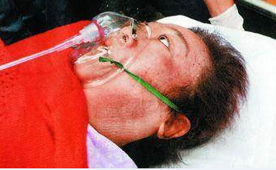
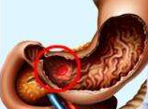
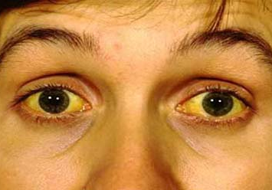
Toxins and Complications
Aromatic amino acid (AAA);
Indoles;
Mercaptans;
Endogenous benzodiazepines; Ammonia;
Prostanoids;
Nitric oxide…
Endotoxin;
Cytokines;
Free radicals…
Bilirubin
Spontaneous peritonitis
Hepatorenal syndrome
Hepatic encephalopathy
Upper gastrointestinal bleeding
Jaundice
Notes:
Here are the main toxins and complications.

Slide 5
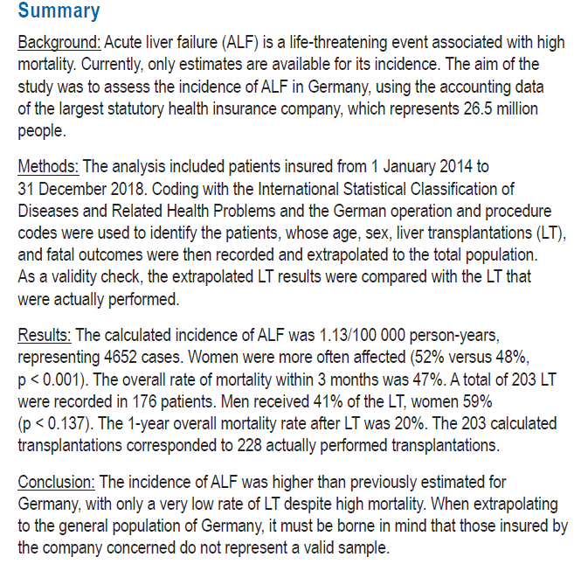
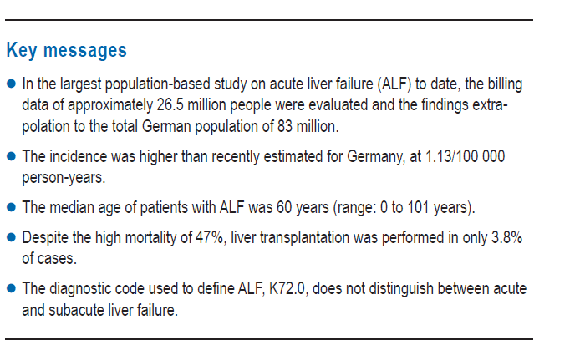
Despite the high mortality of 47%, liver transplantation was performed in only 3.8% of cases.
Weiler, N., Schlotmann, A., Schnitzbauer, A. A., Zeuzem, S. & Welker, M.-W. The epidemiology of acute liver failure. Dtsch. Aerzteblatt Online 117, 43–50 (2020).
Notes:
From the epidemiology of acute liver failure published in 2020, it mentioned that the mortality of ACL is around 47%, however the liver transplantation was performed in only 3.8% of cases.

Slide 6
Acute on chronic liver failure - epidemiology
High prevalence with 50% mortality rate;
The costs of treating ACLF and the mortality rates are far greater than those associated with more common causes for hospitalization.
Recent studies have suggested that there are approximately 700,000 hospitalizations a year in the United States for cirrhosis, 32,335 of which have ACLF (5% of all hospitalizations for cirrhosis).
Mortality rates from ACLF have been decreasing from 2001 to 2011 from approximately 65% to currently 50% per hospitalization.
The mean hospitalization cost of US $14,894 for patients with cirrhosis and US $51,841 for patients with ACLF. In contrast, the per‐hospitalization cost for patients with congestive heart failure is US $10,775, for pneumonia US $7,206, and for sepsis US $19,330. The mean length of stay for patients with ACLF is 16 days, compared with 5.2 days for pneumonia, 5 days for congestive heart failure, and 8.8 days for sepsis. Thus, the costs of treating ACLF and the mortality rates are far greater than those associated with more common causes for hospitalization.
Sarin, S. K. et al. Acute-on-chronic liver failure: consensus recommendations of the Asian Pacific association for the study of the liver (APASL): an update. Hepatology International 13, (2019).
Notes:
On the other hand, for the guideline of Asian pacific association for the study of the liver, it mentioned The costs of treating ACLF and the mortality rates are far greater than those associated with more common causes for hospitalization.

Slide 7
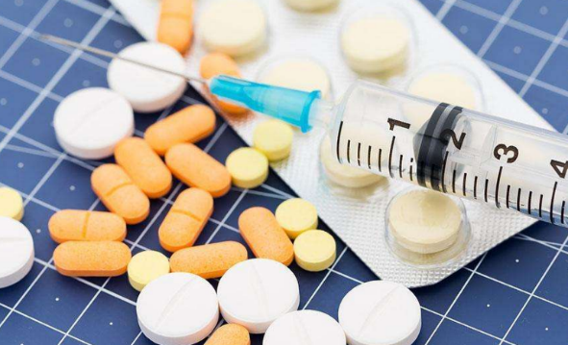
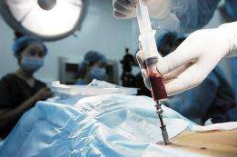
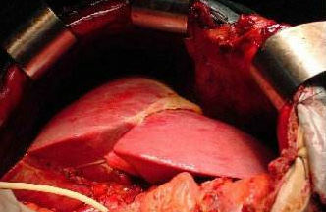
Treatment Methods
Medicine
Stem cell
Transplantation
1. Slow effect and limited function;
2. No water, electrolyte and acid-base balance adjustment;
3. Liver dysfunction can’t be repaired in a short time;
4. With single medical treatment, the mortality rate of liver failure is 60-80%.
Add stem cells, induce them to differentiate into liver cells, fill hepatocyte necrosis area.
It is a welcome research, but immature right now.
Liver transplantation is the last method for liver failure patients.
It faces donor shortage and high cost.
Notes:
Pharmacological Therapy: with disease-specific medical therapy, the mortality rate of liver failure is 60-80%
Liver Transplantation: definitive Rx for select group of liver failure patients . Donor shortage and high cost.
Stem Cell Therapy: in research status, immature for clinical practice
Artificial Liver Support System (ALSS): bridging therapy till regeneration of liver function OR liver transplant

Slide 8
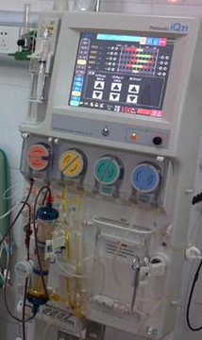
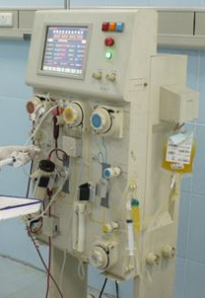
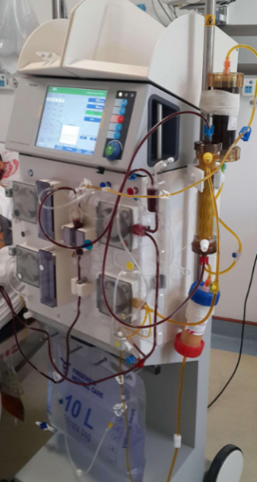
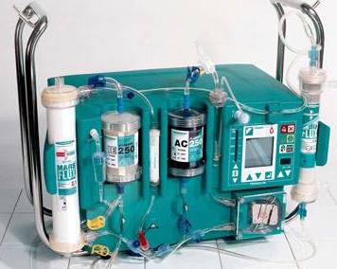
Treatment Methods
Artificial Liver Support System (ALSS)
An extracorporeal support system which temporarily replace partial liver function.
Non-biological ALSS
Molecular absorbent
recycling system (MARS)
……
HD/HF/HDF
Plasma exchange (PE)
Plasma/blood adsorption
Notes:
Apart from those, ALSS is an extracorporeal support system which can temporarily replace partial liver function.
Non-biomedical artificial liver support system is commonly used in clinic for liver failure patients.
Today we will focus on plasma adsorption therapy, DPMAS.

Slide 9
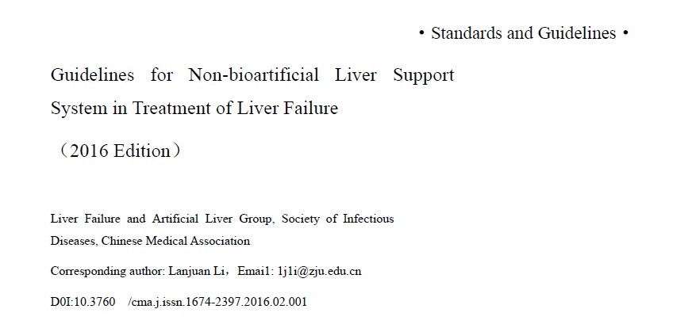
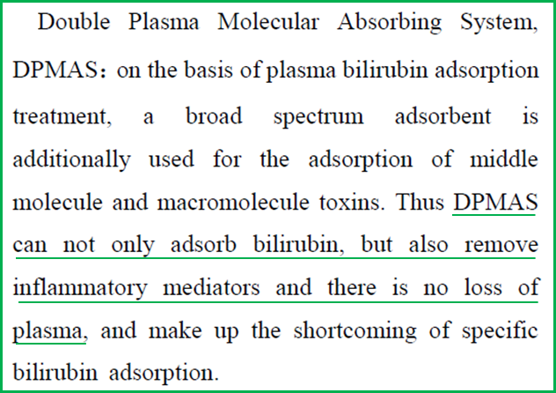
Background of DPMAS
Epidemiology branch of Chinese medical association, liver failure and artificial liver group. Guidelines for the treatment of liver failure by non-biological artificial liver (2016) [J]. Chinese journal of clinical infectious diseases, 2016,9(2):97-103.
Notes:
DPMAS is the short of Double Plasma Molecular Adsorption System. It was listed in the National Guidelines for Non-bioartificial Liver Support System in Treatment of Liver Failure in 2016. As written, DPMAS can not only adsorb bilirubin, but also remove inflammatory mediators, besides, there is no loss of plasma. So what is DPMAS?

Slide 10
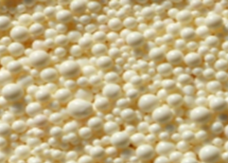
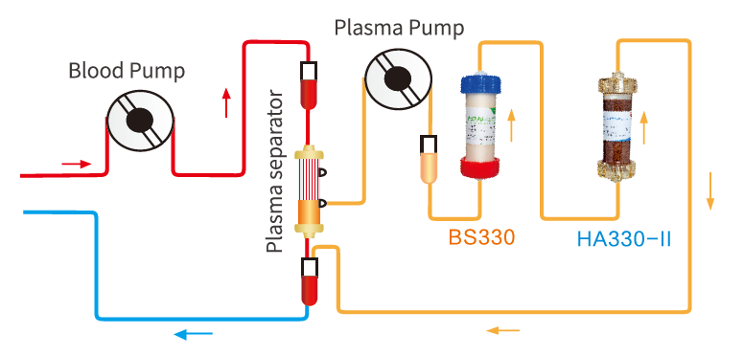
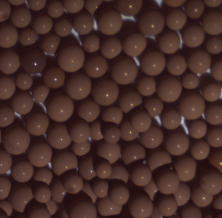
Principle of DPMAS
DPMAS (Double Plasma Molecular Adsorption System)
A blood purification system, combination of BS330 and HA330-II adsorption cartridge.
Specifically adsorb bilirubin and bile acid.
Remove other middle molecular toxins induced by liver disorder, such as inflammatory mediators, ammonia, phenol, mercaptan, etc.
Anion-exchange Resin
Neutro-macroporous Resin
Notes:
Well, as we shows. DPMAS is a combination of HA330-2 and BS330 in the plasma adsorption mode. HA330-2 and BS330 are the two different hemoperfusion cartridges. Inside the BS330 are the anion-exchange resin on which the ions are embedded, so when the plasma goes through the anion-exchange resin, only the bilirubin and bile acid will be adsorbed specifically. However, the resin inside the HA330 hemoperfusion cartridge are netro-macroporous resin which could remove the middle to large molecule due to liver dysfunction, including inflammatory mediators, ammonia, phenols and mecaptans.

Slide 11
Principle of DPMAS

Slide 12
Indication of DPMAS
Notes:
Based on the principle, DPMAS could be applied for patients with complications such as hepatic encephalopathy, used as a bridge to liver transplantation to provide a stable in vivo environment. Besides, DPMAS could be conducted for patients with hepatitis and relieve the jaundice which is a very common clinical symptom.

Slide 13
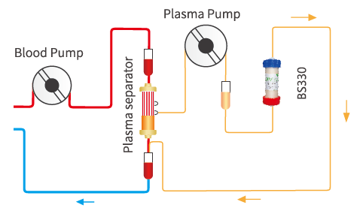
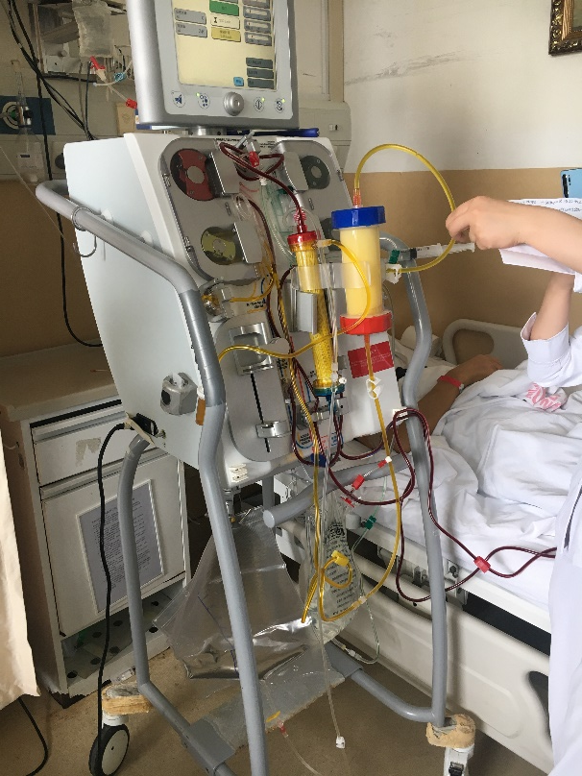
Single Treatment of BS330
BS330
plasma adsorption
When bilirubin is ten times more than normal value, which is > 222.4μmol/L (13mg/dl).
Notes:
Deciliter
血清总胆红素的正常参考值：5.13～22.24μmol/L（0.3～1.3mg/dl）
PT prothrombin time
PTA Prothrombin activity

Slide 14
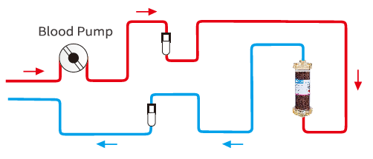
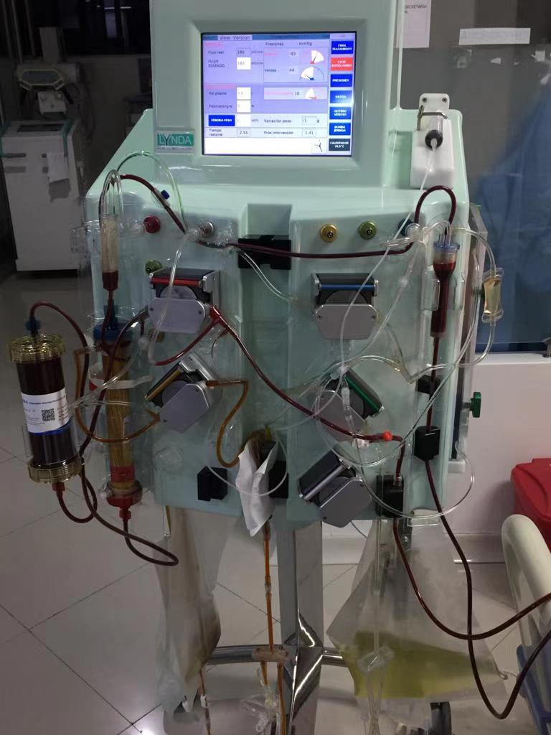
Single treatment of HA330-II
HA330-Ⅱ
direct blood adsorption
Drug or poison caused liver damage
Obvious poisoning symptoms, lighter liver damage, bilirubin is less than ten times of normal value, which is < 222.4μmol/L (13mg/dl).

Slide 15
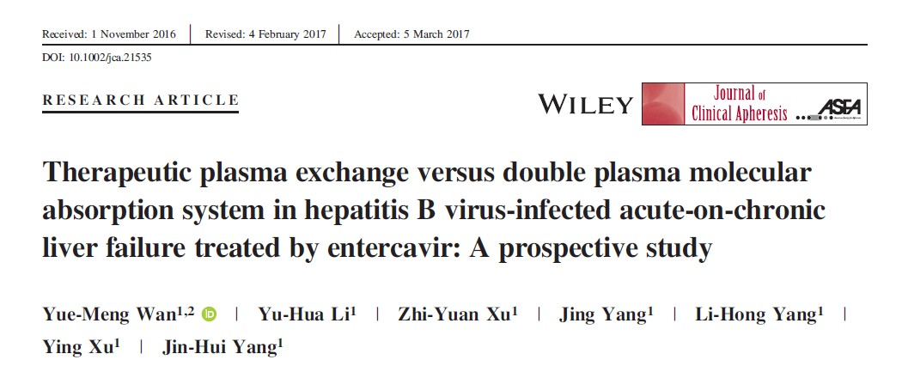
Study – DPMAS for ACLF
Wan Y M, Li Y H, Xu Z Y, et al. Therapeutic plasma exchange versus double plasma molecular absorption system in hepatitis B virus‐infected acute‐on‐chronic liver failure treated by entercavir: A prospective study[J]. Journal of Clinical Apheresis, 2017.
Notes:
As we know plasma exchange is a common treatment method for liver failure patients. In this prospective study, they compared the Plasma exchange with DPMAD therapy for acute on chronic liver failure patients.

Slide 16
Study – DPMAS for ACLF
Design : A single center prospective controlled pilot study.
Study Subject: Acute-on-chronic liver failure (ACLF)
Regimens:
Follow-up: 12 weeks
Purpose: compare the efficacy of TPE and DPMAS on acute-on-chronic liver failure (ACLF) caused by hepatitis B virus (HBV-ACLF).
TPE Group (N=33) | Standard medical therapy + TPE (2-3 times/w, 2-3h/session) * Plasma exchange rate: 20-30ml/min.
DPMAS Group (N=27) | Standard medical therapy + DPMAS (2-3 times/w, 2-3h/session) * Blood flow rate: 100-150ml/min, Plasma flow rate: 25-50ml/min.
* TPE: therapeutic plasma exchange
DPMAS: double plasma molecular adsorption system
Wan Y M, Li Y H, Xu Z Y, et al. Therapeutic plasma exchange versus double plasma molecular absorption system in hepatitis B virus‐infected acute‐on‐chronic liver failure treated by entercavir: A prospective study[J]. Journal of Clinical Apheresis, 2017.
Notes:
In this single center prospective controlled pilot study, there are totally 60 patients involved who are divide into 2 groups, therapeutic plasma exchange group with 33 patients and DPMAS group with 27 patients.

Slide 17
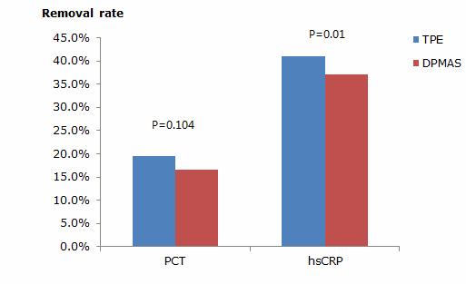
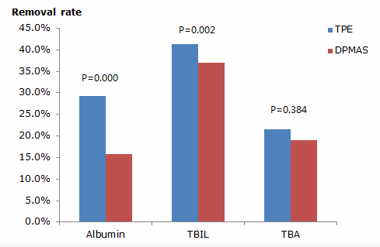
Study – DPMAS for ACLF
Obvious decrease of PCT, hsCRP, TBIL,TBA & less loss of albumin
Wan Y M, Li Y H, Xu Z Y, et al. Therapeutic plasma exchange versus double plasma molecular absorption system in hepatitis B virus‐infected acute‐on‐chronic liver failure treated by entercavir: A prospective study[J]. Journal of Clinical Apheresis, 2017.
Notes:
And let’s see the results. No matter plasma exchange or DPMAS could effectively reduce the inflammatory mediators, bilirubin and bile acid. Meanwhile, they found that patients with DPMAS treatment will have less loss of albumin when compared with TPE with a larger amount of plasma lost. Actually, we know that, the plasma separator with a pore size of 0.2-0.6 mm allows passage of all plasma constituents, including albumin, which will be discarded in TPE and lead to albumin lost.

Slide 18
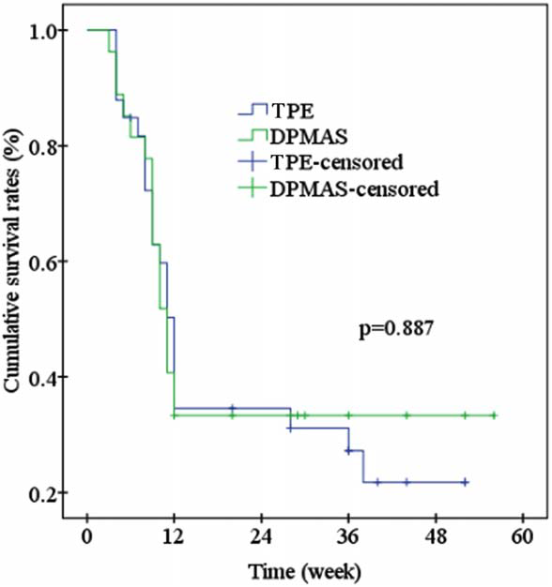
Study – DPMAS for ACLF
Adverse Events | TPE | DPMAS
Allergic reaction | 3 (9.09%) | 0 (0)
Shock (hypotension, chill, sweat and palpitate) | 3 (9.09%) | 0 (0)
Nausea | 6 (18.18%) | 2 (7.41%)
Significant bleeding in the puncture site | 4 (12.12%) | 1 (3.70%)
Treatment interrupted (clotting induced) | 2 (6.06%) | 1 (3.70%)
Less adverse events & higher safety
Wan Y M, Li Y H, Xu Z Y, et al. Therapeutic plasma exchange versus double plasma molecular absorption system in hepatitis B virus‐infected acute‐on‐chronic liver failure treated by entercavir: A prospective study[J]. Journal of Clinical Apheresis, 2017.
Notes:
Besides, the survival rate of DPMAS and TPE have no difference. But when they took a look at adverse events, they found that DPMAS is much better tolerated.

Slide 19
Study – DPMAS for ACLF
Conclusion:
DPMAS and TPE were both effective and safe therapeutic approaches for HBV-ACLF patients treated by Entecavir.
Despite TPE resulted in higher removal rates of TBIL, DBIL, and hsCRP, but it was
disadvantageous as follows:
a) requirement of large volumes of fresh frozen plasma;
b) risk of plasma allergies
c) blood-borne disease transmission
d) higher loss rate of albumin than DPMAS.
Wan Y M, Li Y H, Xu Z Y, et al. Therapeutic plasma exchange versus double plasma molecular absorption system in hepatitis B virus‐infected acute‐on‐chronic liver failure treated by entercavir: A prospective study[J]. Journal of Clinical Apheresis, 2017.
Notes:
So here is the conclusion.

Slide 20
Pros & Cons of PE
PROS
CONS
The risk of cross infection
Shortage of plasma sources
To eliminate toxic substances, with protein and clotting factor supplements
Varying degrees of allergy
Obvious dose-effect relationship

Slide 21
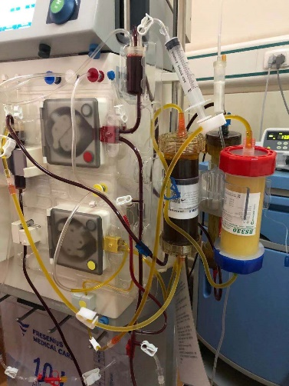
Pros & Cons of DPMAS
PROS
CONS
No risk of cross infection
Do not require plasma
No protein and clotting factor supplements
Less allergy
Double dose treatment

Slide 22
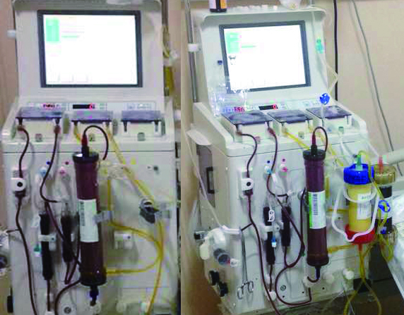
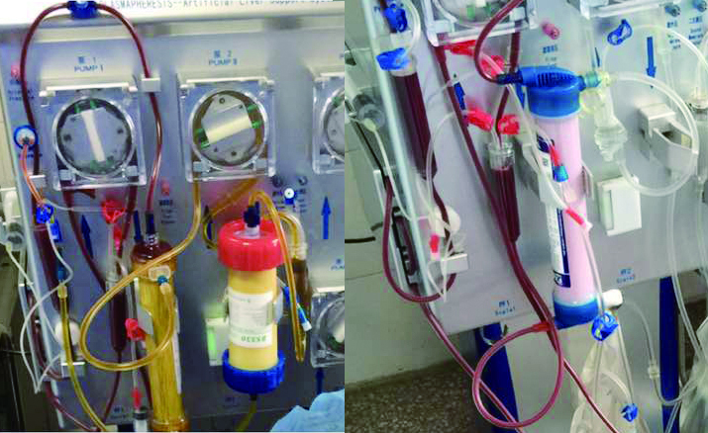
Hybrid Treatment Modes
DPMAS+PE
DPMAS+CVVH
1. Associated with coagulopathy; 2. Need to supplement nutriment, e.g. coagulating substances, protein and other materials.
1. Associated with renal dysfunction, water electrolytes and acid base disturbance; 2. Associated with unstable hemodynamic; 3. Patients with MODS.
Notes:
Apart from single DPMAS, it can combine with other treatment method such as plasma exchange and CVVH.

Slide 23
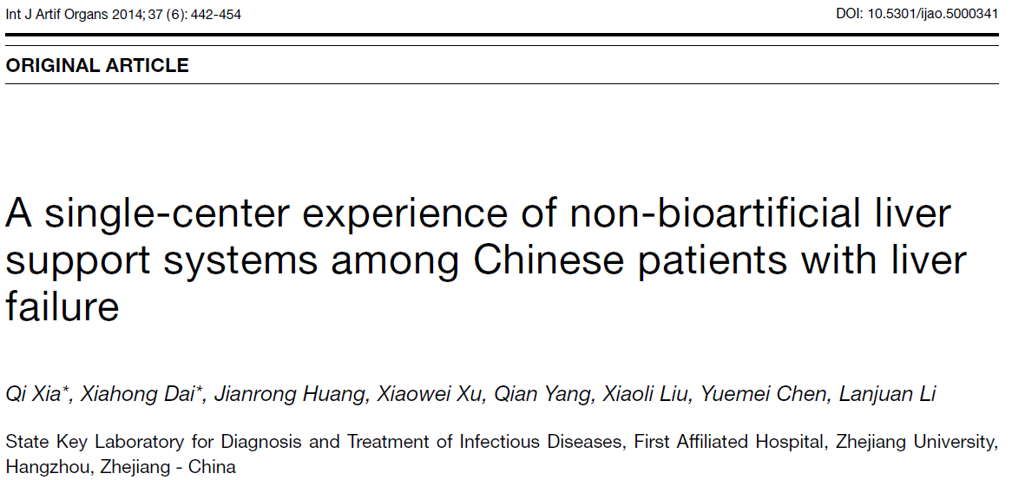
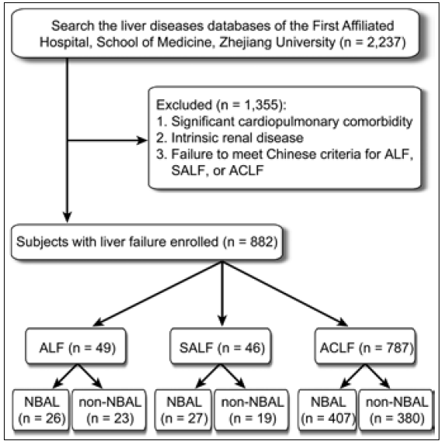
Study – Hybrid Treatment
Design : A single center retrospective controlled study.
Study Subject: Liver failure patients
Methods:
Purpose:
To investigate the status of NBALs and their effectiveness in improving survival in liver-failure patients.
* NBALs: Non-bioartificial Liver Support
NBALs group (N=460) | Conventional medications +NBALs
non-NBAL group (N=422) | Conventional medications alone
Xia Q, Dai X, Huang J, et al. A single-center experience of non-bioartificial liver support systems among Chinese patients with liver failure.[J]. International Journal of Artificial Organs, 2014, 37(6):442.
Notes:
So next, I would like to share a research on the basic of hybrid treatment mode.

Slide 24
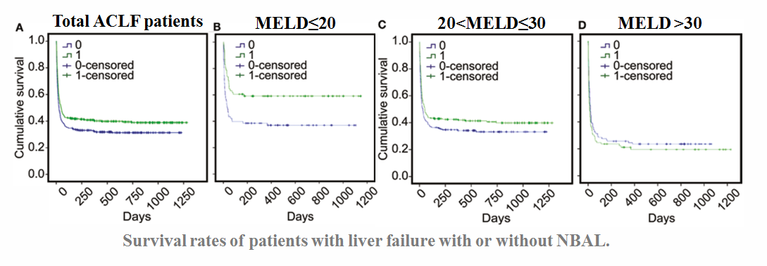
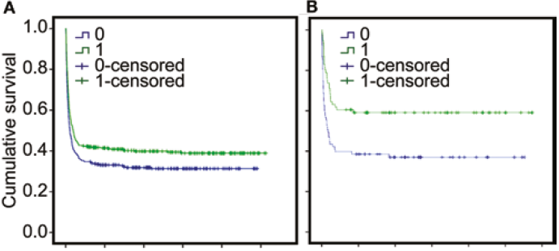
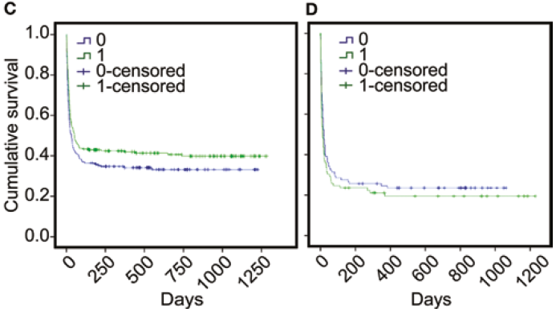
Study – Hybrid Treatment
Total ACLF patients
MELD≤20
20<MELD≤30
MELD >30
Survival rates of patients with liver failure with or without NBAL.
0 patients with non- NBAL;
1 patients with NBALs.
Better 48-week survival rate of ACLF patients with MELD <30
Notes:
The 48-week survival rate of the ACLF patients with NBAL was higher than that of the ACLF patients without NBAL in the MELD≤20 and 20<MELD≤30 subgroups (p<0.05).
Model to evaluate liver disease

Slide 25
Study – Hybrid Treatment
Conclusion:
NBAL treatment improved the survival of patients with ALF, SALF, or ACLF.
The reasonable combination of purification technologies maximizes the advantages and minimizes the disadvantages of each approach.
Lower MELD scores were associated with improved outcomes relative to higher MELD scores.
Notes:
And here is the conclusion.

Slide 26
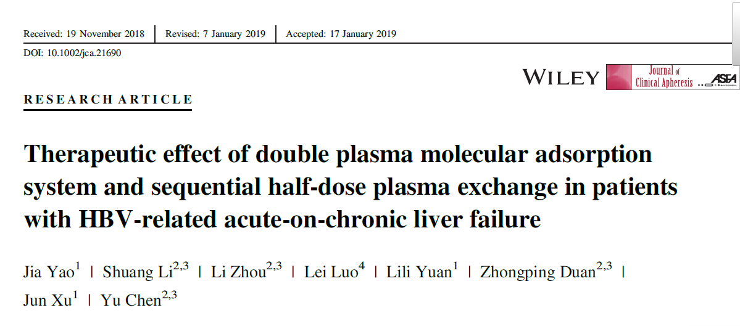
Study – DPMAS+PE for ACLF
Design: A retrospective controlled study
Methods:
Outcome:
Organ Function
28-days liver transplant-free survival rates
PE N=54 | PE with fresh frozen plasma 2.2-2.4L; * Treatment duration 2hrs
DPMAS+PE N=77 | DPMAS first, followed by PE with fresh frozen plasma 1.1-1.2L ; * Treatment duration:3-4hrs
Follow-up：28 days

Slide 27
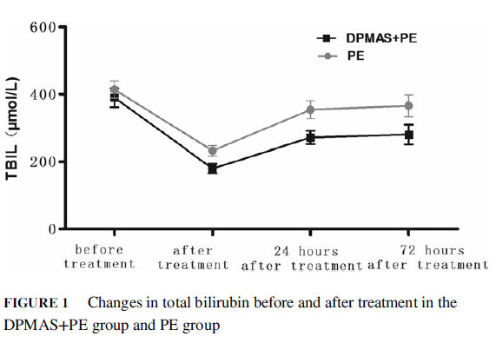
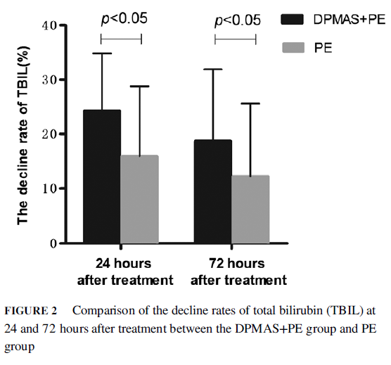
Study – DPMAS+PE for ACLF
The total bilirubin (TBIL) levels decrease immediately after treatment, and at 24 and 72 hours after treatment were markedly decreased in DPMAS+PE group than that in PE group (P<0.05).

Slide 28
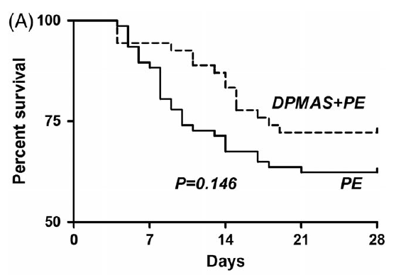
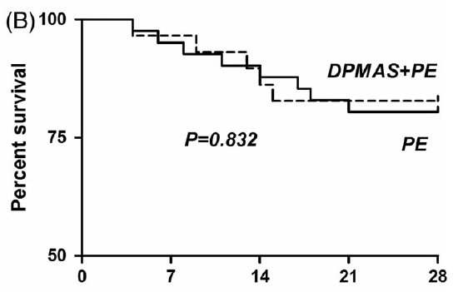
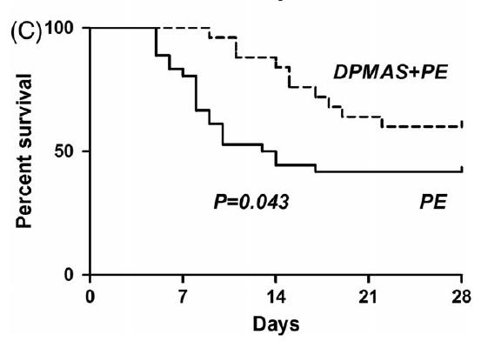
Study – DPMAS+PE for ACLF
(A) All included patients.
(B) The early stage patients
(C) The intermediate-advanced stage patients
FIGURE 3 Comparison of liver transplantation free hospital survival at 28-days after treatment between PE group and DPMAS+PE group.
The 28-days survival rates was 62.3% and 72.2% in PE and DPMAS+PE groups.
The 28-days survival rates in DPMAS+PE group were significantly higher than that in PE group (57.4% vs 41.7%, P = 0.043) in the intermediate-advanced stage patients.

Slide 29
Study – DPMAS+PE for ACLF
Conclusion:
Compared with PE treatment alone, DPMAS+PE might more effectively improve the liver function and reduce the rebound of bilirubin in patients with ACLF.
DPMAS+PE might more effectively improve the 28-days liver transplantation free hospital survival rates in HBV-ACL patients with intermediate-advanced stage.
DPMAS+PE may be an available ALSS approached treatment for HBV-ACLF.
Further prospective studies are needed to investigate the effect of DPMAS+PE on long-term survival.
Notes:
And here is the conclusion.

Slide 30
Patient Selection for DPMAS
Inclusion criteria
1. Serum bilirubin≥5mg/dl(85umol/L);
2. Early and intermediate-advanced stage liver failure; 20%<PTA<40% or PTA>40%; PLT>60*10⁹/L;
3. Pre and post liver transplantation;
Exclusion criteria
Patients with active bleeding or disseminated intravascular coagulation (DIC);
Patients with infarct in unstable phase caused by cardiocerebral events;
Terminal stage.
Patients with complicated and severe infection.
Notes:
Deciliter
血清总胆红素的正常参考值：5.13～22.24μmol/L（0.3～1.3mg/dl）
PT prothrombin time
PTA Prothrombin activity

Slide 31
Machine Compatibility

Slide 32
Global Footprints
6000 ⁺
Hospitals
Dialysis Clinic / ICU / Hepatology / Emergency
80 ⁺
Countries
Europe/ Middle-East / Asia / South America / Africa
3 million
Cases (Annually)
Sepsis/ Intoxication / ESRD / Liver Failure

Slide 33
Take Home Messages
Liver failure is a live threatening condition. DPMAS is a powerful weapon for Liver failure.
Studies demonstrated that DPMAS has shown outstanding results for liver failure patients.
Easy operation and compatible with CRRT machines.

Slide 34
Jafron: make every resin with best quality
Contact Us:
+86 (756) 3689 708
en.jafron.com
support@jafron.com
98, Technology Six Road, High-Tech Zone, 519085, Zhuhai, China

