Slide 1
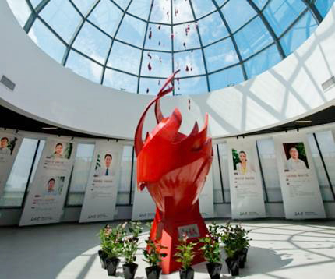
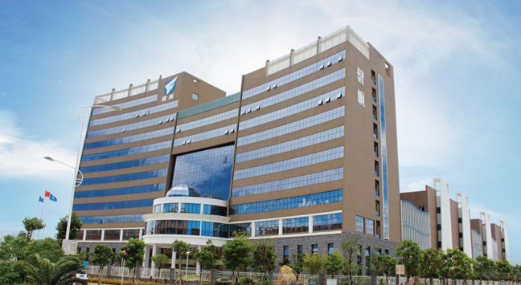
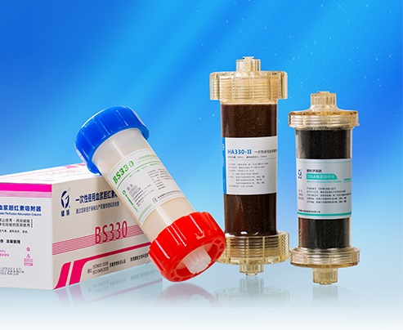
HA130 FOR DIALYSIS PATIENTS

Slide 2
1
Background of dialysis patients’ situations
2
Introduction and benefits of HA130
3
Application of HA130 on ESRD patients

Slide 3
1
Background of dialysis patients’ situations
2
Introduction and benefits of HA130
3
Application of HA130 on ESRD patients

Slide 4
Background of dialysis patients’ situations
Chronic Kidney Disease(CKD) is defined as abnormalities of kidney structure or function, present for >3 months, with implications for health.
Kliger A S, Foley R N, Goldfarb D S, et al. KDOQI us commentary on the 2012 KDIGO clinical practice guideline for anemia in CKD[J]. American Journal of Kidney Diseases the Official Journal of the National Kidney Foundation, 2013, 62(5):849-59.

Slide 5
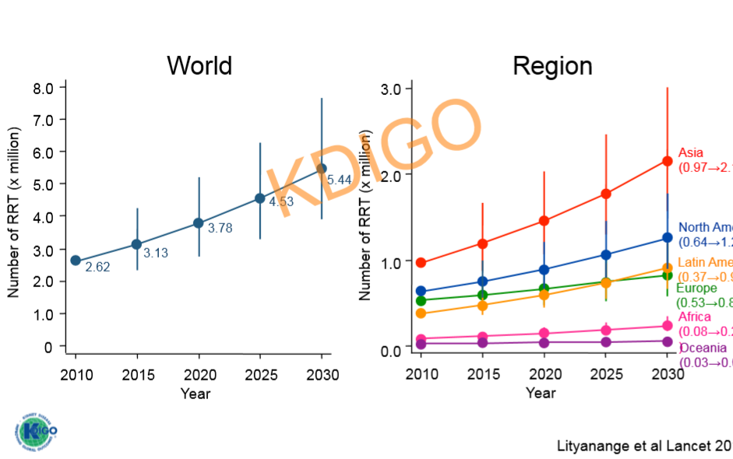
Background of dialysis patients’ situations
Trend in the estimated number of dialysis patients

Slide 6
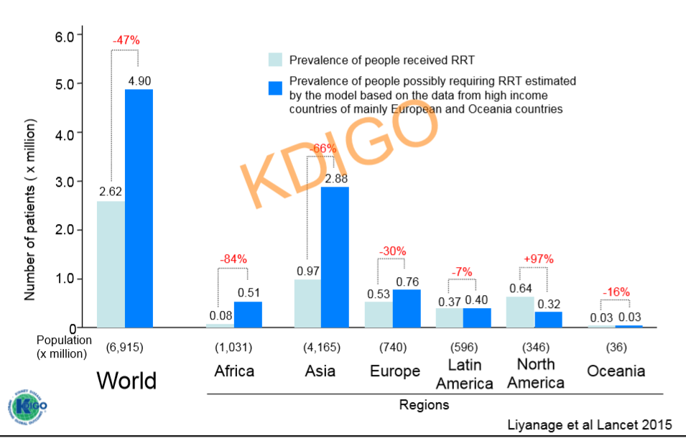
Background of dialysis patients’ situations
Difference between numbers of people on and those who need CRRT

Slide 7
Background of dialysis patients’ situations
Causes of ESRD related complications
Uremic toxins | Long-term complications
Parathyroid hormone （PTH） | Renal Osteopathy, Ectopic Calcification, Uremic Pruritus
β2-microglobulin（β₂-MG） | Amyloidosis and Carpal Tunnel Syndrome
Renin, Angiotensin | Refractory Hypertension
Advanced Glycation End Products（AGEs）, Homocysteine （Hcy） | Risk Factors of Cardiovascular Diseases
Leptin | Malnutrition, Hypertension, Insulin Resistance, Affecting Immunoreaction
Tumor necrosis factor （TNF）, interleukin （IL）, C-reactive protein （CRP） | Chronic Inflammatory Reaction, Malnutrition, Anemia
Advanced oxidation protein products （AOPP） | Atherosclerosis

Slide 8
1
Background of dialysis patients’ situations
2
Introduction and benefits of HA130
3
Application of HA130 on ESRD patients

Slide 9
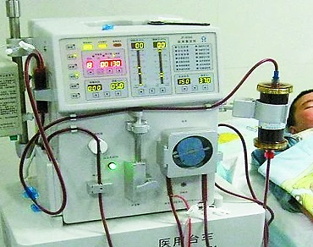
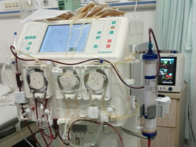
Introduction and benefits of HA130
Hemodialysis （HD）
Small water soluble substance
2
Hemodiafiltration （HDF）
Water soluble substance
Small molecules
Part of middle molecules
1
Hemoperfusion （HP）
Middle molecules
Protien bound toxins
3
4
Hemofiltration （HF）
Water soluble substance
Part of Middle molecules

Slide 10
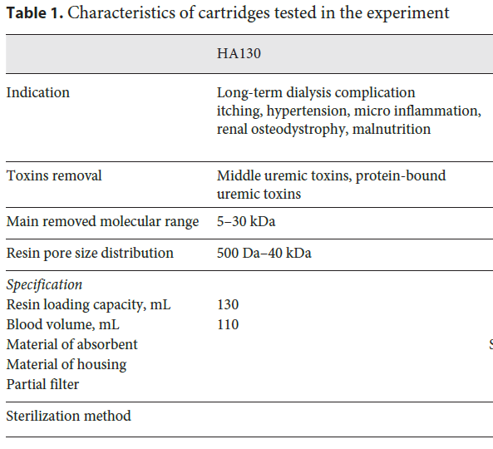
Introduction and benefits of HA130
Hemoperfusion is an extracorporeal blood purification modality that consists of the passage of anti-coagulated whole blood through a device, usually a column, that contains adsorbent particles. It is usually used for removal of toxins, drugs and metabolites from blood.
Fig. 1. Neutro-macroporous resin adsorbing beads made of styrene-divinylbenzene copolymer (a). In (b, c), pictures made by transmission electron microscopy (TEM) of beats surface and section with the pore.
Montin, Diego Pomarè, et al. Blood purification, 2018;46(3):187-95.

Slide 11
Introduction and benefits of HA130
HA130 Hemoperfusion cartridge：principle

Slide 12
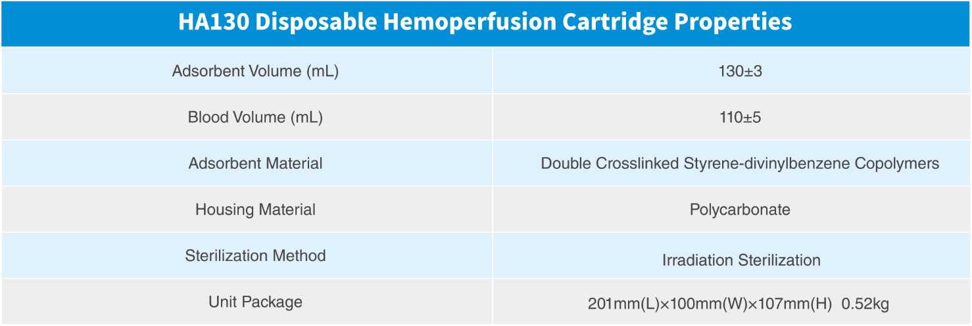

Slide 15
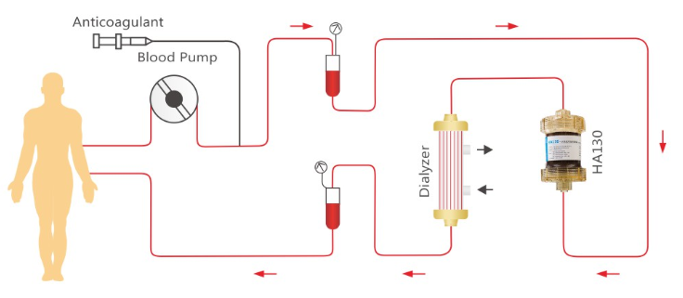
Introduction and benefits of HA130
Combined Artificial Kidney （HA130+HD/HDF）
Small Uremic Toxin
Part Middle Uremic Toxin
HD/HDF
+
HP
Middle Uremic Toxin
Protein-bound Uremic Toxin
Ideal combination
(HA130+HD/HDF)
Treatment Period：4 hrs
Target Molecular Weight：5-30 kDa
Adsorption Surface (m²)：18,000-20,000

Slide 16
Health technology assessment (HTA) RESEARCH of HA130
Hemoperfusion treatment can extend life-span
with cost-effectiveness of 2.87 yrs more/＄36,239.
Average of 10.71 yrs
Average of 7.84 yrs
36.6%
HP
WITHOUT
HP
2-3 times BP treatment every week
2-3 times BP treatment every week
(such as HD, HF, HDF)
1 time/2 weeks HP at least
Shanghai RCT health technology assessment

Slide 17
1
Background of dialysis patients’ situations
2
Introduction and benefits of HA130
3
Application of HA130 on ESRD patients

Slide 18
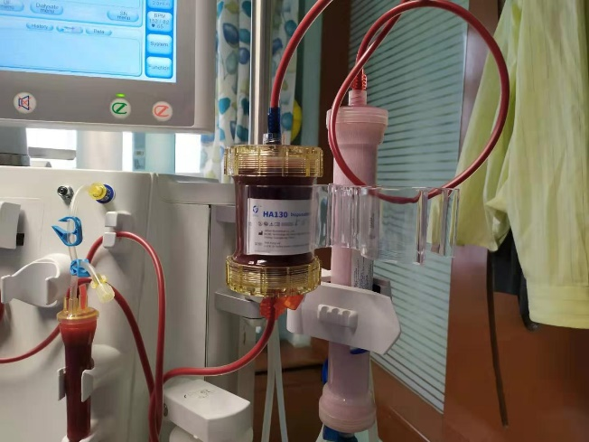
Application of HA130 on ESRD patients
Clinical Indications
PTH> 300 pg/mL and/or β2-m group ≥ 30 mg/L
Presence of the complication of ESRD
Uremic pruritis
Secondary Hyperparathyroidism
Dialysis-related amyloidosis
Resistance hypertension
Sleep disturbances
- It can be used as prophylaxis therapy to prevent the complications of chronic dialysis specially for patients with long-term hemodialysis
Contraindications:
Platelet count <60 × 109/L
Severe hemorrhage tendency or active bleeding
Hypotension: BP <90/60 mmHg
Allergic to hemoperfusion materials

Slide 19
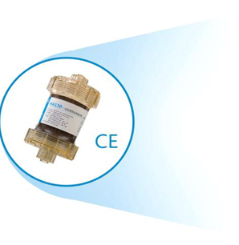
Application of HA130 on ESRD patients
- Uremic pruritis
- Amyloidosis (pain, stiffness of joints)
- Refractory hypertension
- Secondary Hyperparathyroidism
- Sleep disturbances
- Nutrition
- Life quality
- Survival Rate
To Improve
Regimen: Once a week, duration: 4hrs

Slide 20
SHANGHAI Multicenter RCT: Primary Results
30 dialysis centers in Shanghai
Follow-up: 24 months
Patients selection
Enrolled n=1407
(HD,HF,HDF)
3 time/week+
once HP every two weeks
(HD,HF,HDF)
3 time/week
HP group，n=704
Control，n=703
Drop off: 87 cases
Drop off :55 cases
617 cases completed
648 cases completed
B₂-MG and iPTH significantly reduced in HP group compared to control group.
HD+HA130 can significantly reduce all-cause mortality.
The HP group had significant improving in life quality score.
Mortalaty rate in HP group were significantly lower than in the control group.

Slide 21
SHANGHAI Multicenter RCT: Primary Results
Lower β2-MG
Lower PTH
Lower CV Mortality
Lower overall Mortality

Slide 22
National science and technology support RCT program
Beijing Multicenter RCT: Primary Results
Eligible patients (n=440)
LFHD group
n=110
HFHD group
n=110
LFHD+HP group
n=110
HFHD+HPgroup
n=110
3 HD/W，4h each
2 HD+1 HD+HP/ W
Jafron HA130 hemoperfusion combined with low-flux hemodialysis
Good performance on safety
It significantly reduces β2-MG , PTH, and improves pruritus. It is superior to high-flux hemodialysis
Provides a simple, easy and effective blood purification mode for the basic medical institutions

Slide 23
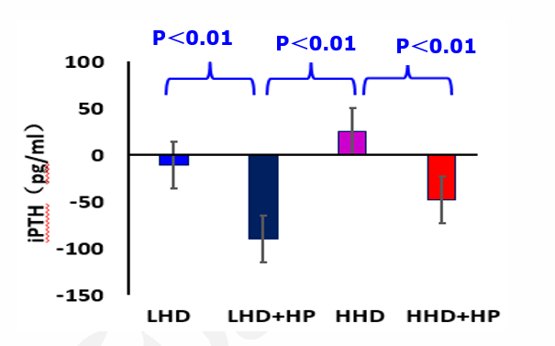
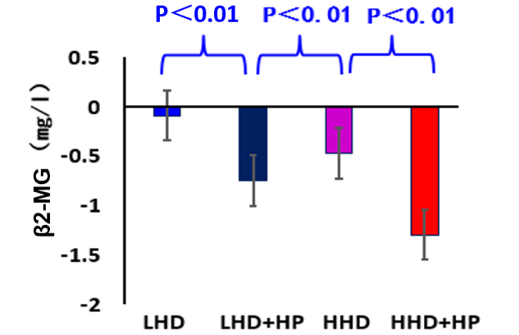
Beijing Multicenter RCT: Primary Results
Comparison of iPTH changes over 12 months
Comparison of β2-MG changes over 12 months
After 12 months of treatment, significant decline rate of iPTH.
After 12 months of treatment, significant decline rate of β2-MG .
After 12 months of treatment, significant improvement of pruritis score

Slide 24
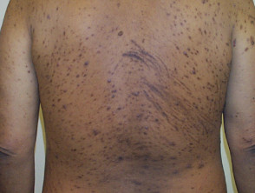
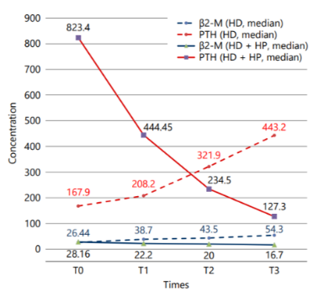
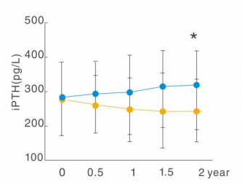
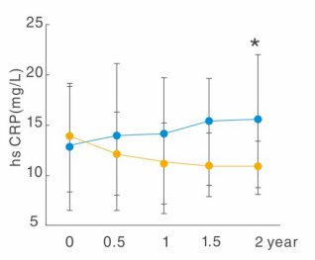
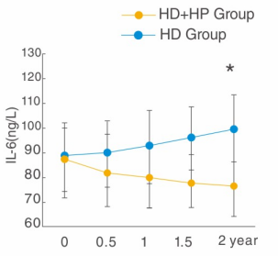
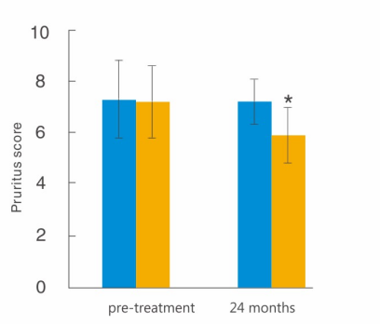
Ha130 and uremic pruritis
HA130 can Reduce uremic toxins specially PTH, regulate the systemic inflammation and thus improve the uremic pruritis.
1. Reduce uremic toxins (PTH, β2-MG) [1,2]
2. Improve systemic inflammation [1,2]
3. Improve pruritis Score [3]
[1] Huu, Dung Nguyen, et al. "A Combination of Hemodialysis with Hemoperfusion Helped to Reduce the Cardiovascular-Related Mortality Rate after a 3-Year Follow-Up: A Pilot Study in Vietnam." Blood purification: 1-8.
[2] Chen, Shun-Jie, et al. "Combination of maintenance hemodialysis with hemoperfusion: a safe and effective model of artificial kidney." The International journal of artificial organs 34.4 (2011): 339-347.
[3] Gu, Yan Hong, et al. "Additional hemoperfusion is associated with improved overall survival and self-reported sleep disturbance in patients on hemodialysis." The International journal of artificial organs 42.7 (2019): 347-353.

Slide 25
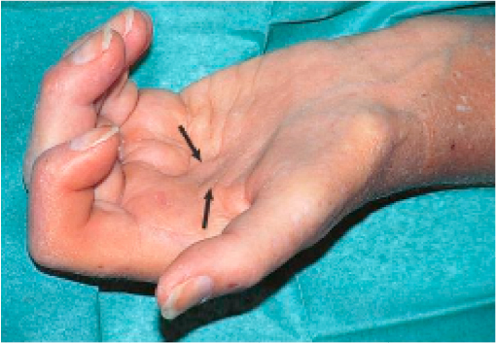
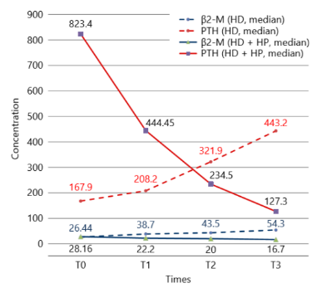
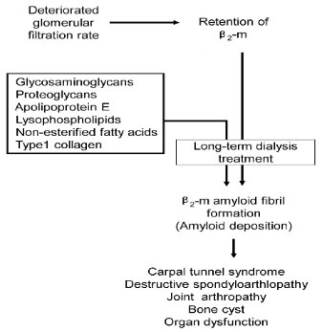
Ha130 and Amyloidosis
HA130 could eliminate the middle uremic toxins such as β2-MG
Beijing and Shanghai RCT showed significant reduction of β2-MG after HP treatment
Published studies showed significant reduction of β2-MG and bone pain after HD+HP treatment compared to HD alone
Table.1Comparison of clinical characteristics of 2 groups after 3 years [1]
Fig.1 Changes of serum PTH and β2-M [1]
Fig.2 Pathogenesis of (DRA) [2]
×
[1] Huu, Dung Nguyen, et al. "A Combination of Hemodialysis with Hemoperfusion Helped to Reduce the Cardiovascular-Related Mortality Rate after a 3-Year Follow-Up: A Pilot Study in Vietnam." Blood purification: 1-8.
[2] Yamamoto, Suguru, et al. "Dialysis-related amyloidosis: Pathogenesis and clinical features in patients undergoing dialysis treatment." Japan: INTECH (2013): 67-83.

Slide 26
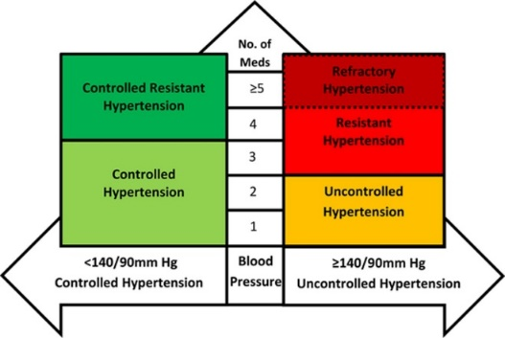
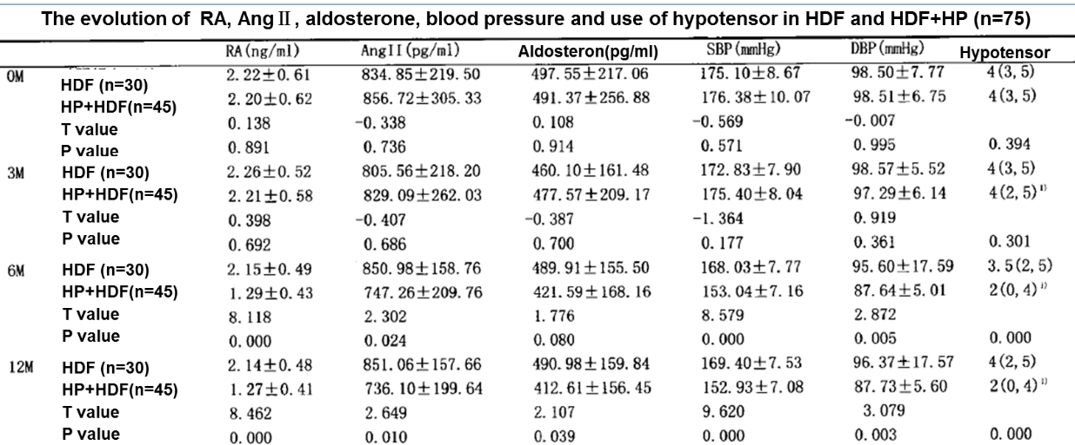
HA130 and Resistant hypertension
Reduce the Renin- Angiotensin II- Aldosterone levels
Reduce the SBP and DBP
Fig.1 Classification of HTN as per number of drugs [1]
[1] Dudenbosten et al.Hypertension 2016
Lu sheng et al Chin J Blood Purif, May,2015,Vol.5,No.14

Slide 27
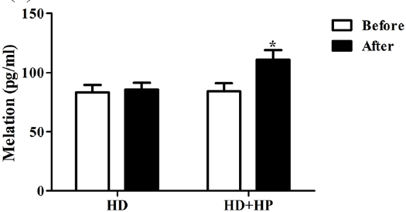
Ha130 AND Sleep disturbances
Reduce PTH levels
Increase Melatonin levels
Relieve pruritis
Improve sleep duration and efficacy
Fig.2 Comparing nocturnal melatonin value between HD and HD + HP groups before and after 24-month follow-up period [1]
Table.1 comparison between sleep related marker between the tow groups [1]
[1] Gu, Yan Hong, et al. "Additional hemoperfusion is associated with improved overall survival and self-reported sleep disturbance in patients on hemodialysis." The International journal of artificial organs 42.7 (2019): 347-353.

Slide 28
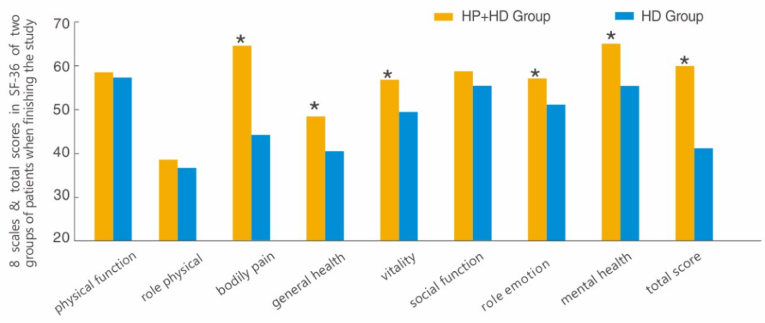
Ha130 AND quality of life
Improve
Body pain
General health
Vitality
Emotional role
Mental health
Total QoL score
* Compared to control group, p<0.05
Chen, Shun-Jie, et al. "Combination of maintenance hemodialysis with hemoperfusion: a safe and effective model of artificial kidney." The International journal of artificial organs 34.4 (2011): 339-347.

Slide 29
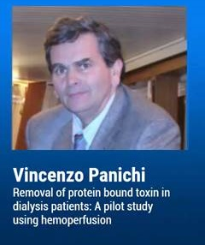
Ha130 AND PROTIEN BOUND TOXINS
Panichi, Vicenzo. “Removal of protein bound toxins in dialysis patients: A pilot study using hemoperfusion” 57 th ERA-EDTA Congress, 6 June 2020, Online. lecture.
https://www.youtube.com/watch?v=dtjPkYiXX6o&t

Slide 30
Ha130 AND PROTIEN BOUND TOXINS
Efficiently reduce protein bound uremic toxins such as indoxyl sulphate and p-cresol
May reduce the cardiovascular events caused by this kind of toxins and reduce the mortality
Panichi, Vicenzo. “Removal of protein bound toxins in dialysis patients: A pilot study using hemoperfusion” 57 th ERA-EDTA Congress, 6 June 2020, Online. lecture.
https://www.youtube.com/watch?v=dtjPkYiXX6o&t

Slide 31
Summary of HA130
Removing of middle uremic toxins
Release complications
- Uremic pruritus
- Sleep disturbances
- Amyloidosis
- Resistant hypertension
- SHPT
Improving life quality
Benefit survival

Slide 32
@Jafron Biomedical
Scan to register
at jafronclub.com
Scan to watch webinar 2020
at jafron.com
Welcome to join us!

Slide 33
THANK YOU!
JAFRON Biomedical Co., Ltd.
Add. : No.98, Technology Six Road, High-tech Zone 519085, Zhuhai, Guangdong, China
Tel: 0086-756-3619708
Web: en.jafron.com

