Slide 1
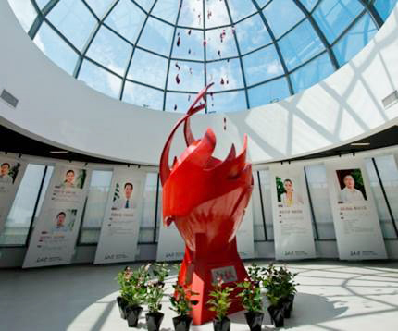
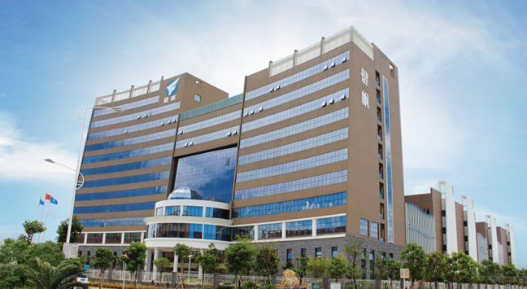
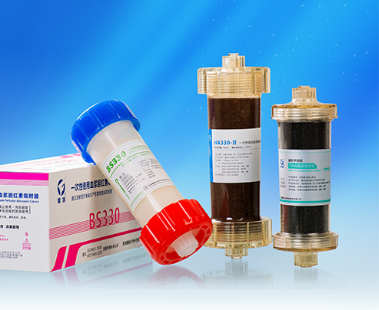
HA380 Hemoperfusion on Critical Care
Version 1.0

Slide 2
1
Introduction
2
Indications of HA380
3
Operation

Slide 3
1
Introduction
3

Slide 4
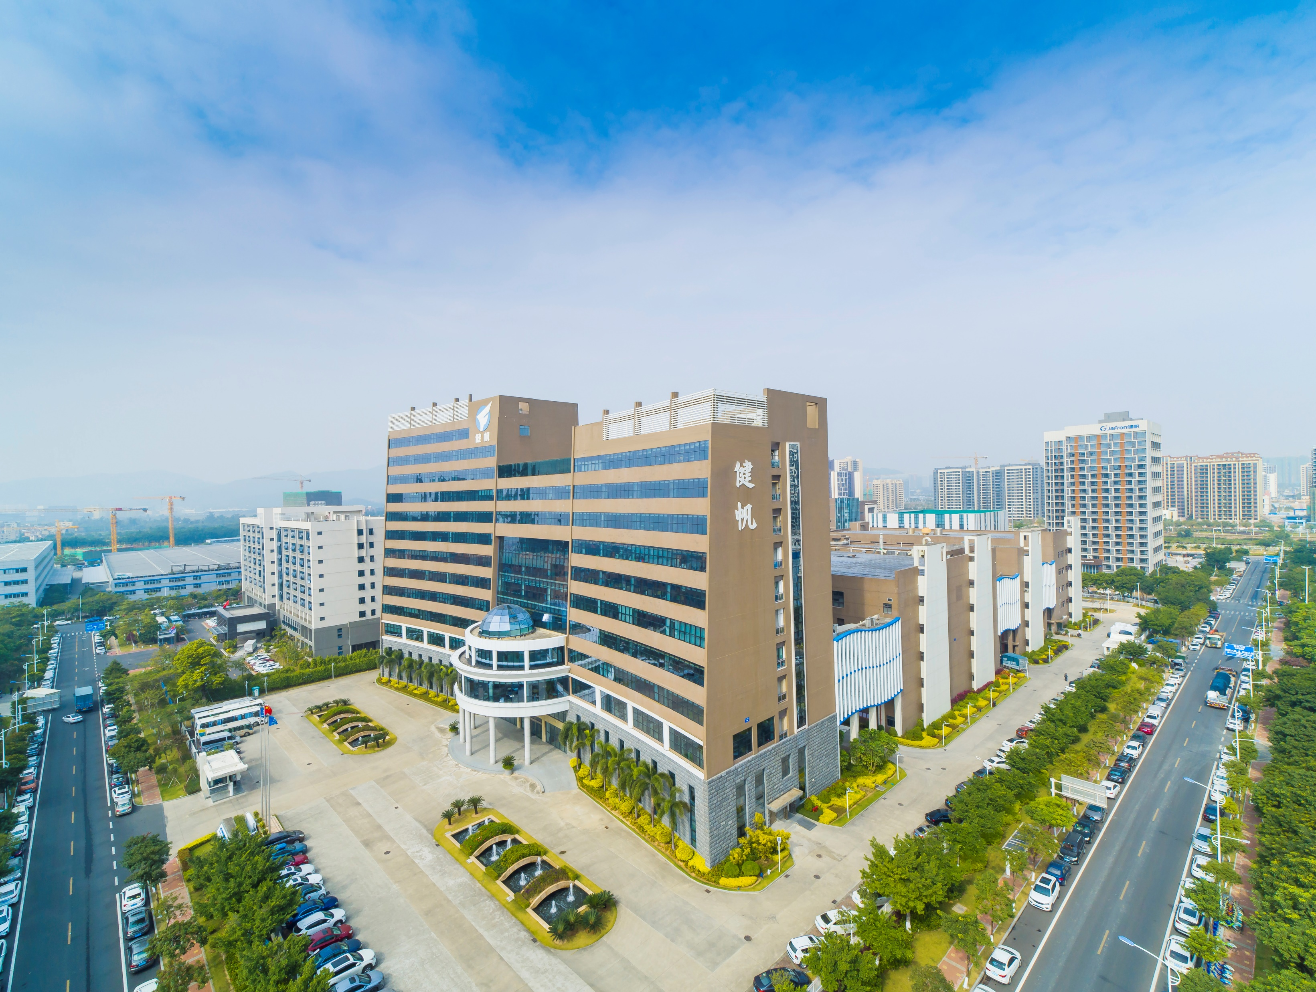
JAFRON biomedical
Sub | Details
Profile | The largest R&D and manufacture enterprise for adsorption column in the world Fully automated production line
Safety | CE certificate, ISO 9001, ISO 13485, GMP, China Food and Drug Adminstration IRRIV lab test
Clincal experience | Annual use of more than 3 million applications (80+ countries, 6000+hospitals, 800+ hospitals out China) 100+ Peer Reviewed International Publications
Products | Various indications with unique cartridges (Sepsis/ Intoxication / ESRD / Liver Failure)
Economic | Fast growth & Reasonable cost
Jafron Corporate
Jafron Oversea
~40% Annual Growth in 2020
~180% Annual Growth in 2020
Notes:
International Renal Research Institute of Vicenza.

Slide 5
Definition of Hemoperfusion (HP)
Hemoperfusion is a blood purification therapy based on adsorption technology, using adsorbent to clear toxins, drugs and metabolites from blood.
Blood
Flow direction
Resin
RBC
Small molecules
Aim molecules
Aim molecules
Notes:
Hemoperfusion is a blood purification treatment based on adsorption technology, using adsorbent to clear toxins, drugs and metabolites from blood. Inside the cartridge, the resins with specific structure play the role of absorbent.
During the HP treatment, blood will go from the bottom to the top, the small molecular will go through the resins, and the aim molecules like middle-large size toxins or protein-bound toxins will be caught in the resins, while the blood cells pass by without damage.

Slide 6
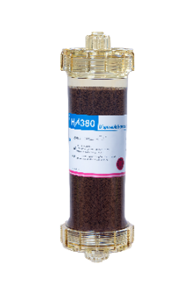
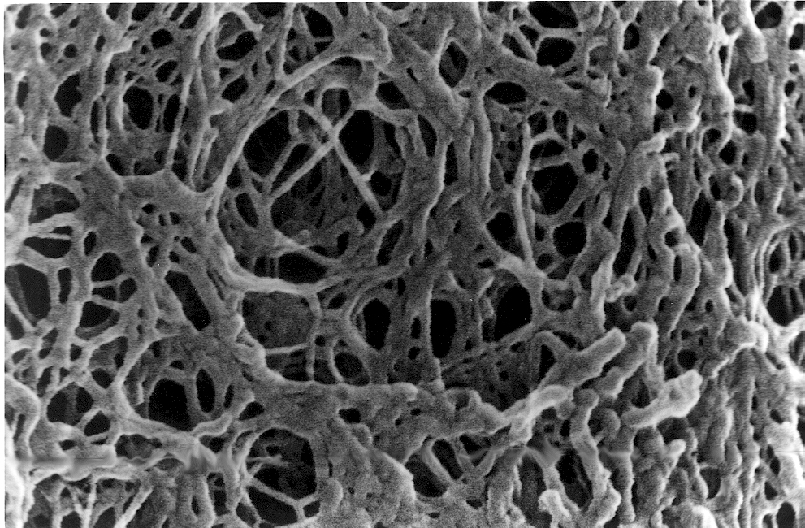
Neutral Macroporous Resin
HA type
The molecular sieve
Effectively adsorb middle-large molecules and protein bound substances

Slide 7
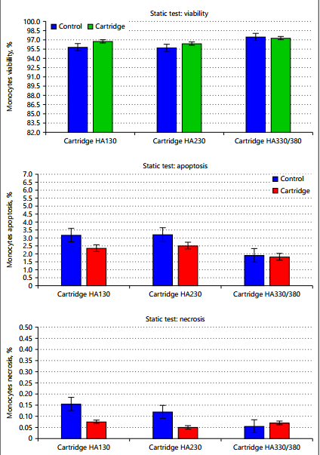
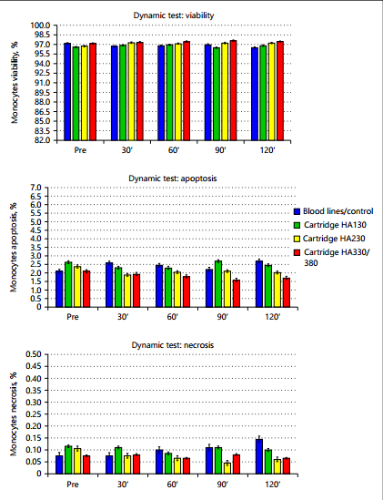
Safety: Lab monocyte test
Results
No evidence of increased necrosis or apoptosis in monocytes exposed to the cartridges both in the static and dynamic tests.
HA cartridges carry an level of biocompatibility and their use in HP is not associated with adverse reactions or signs of cytotoxicity.
Static Test
Dynamic Test

Slide 8
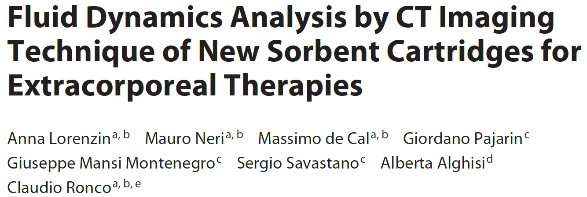
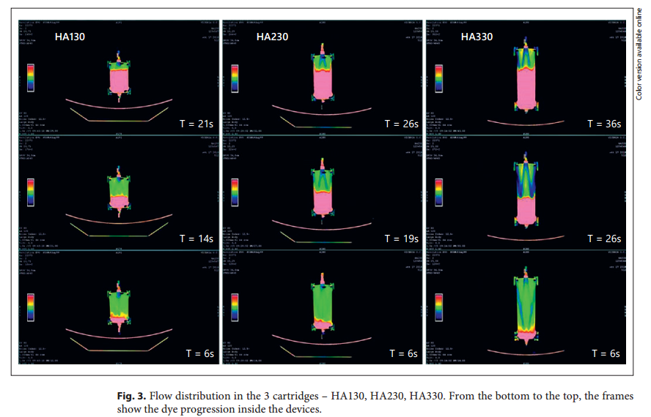
Safety: Radiological results
Results
Sequential CT images demonstrated an excellent distribution of the flow inside the cartridges.
The structural and functional design of the studied cartridges is adequate for hemoperfusion without channeling phenomena.

Slide 9
2
Indications of HA380
3

Slide 10
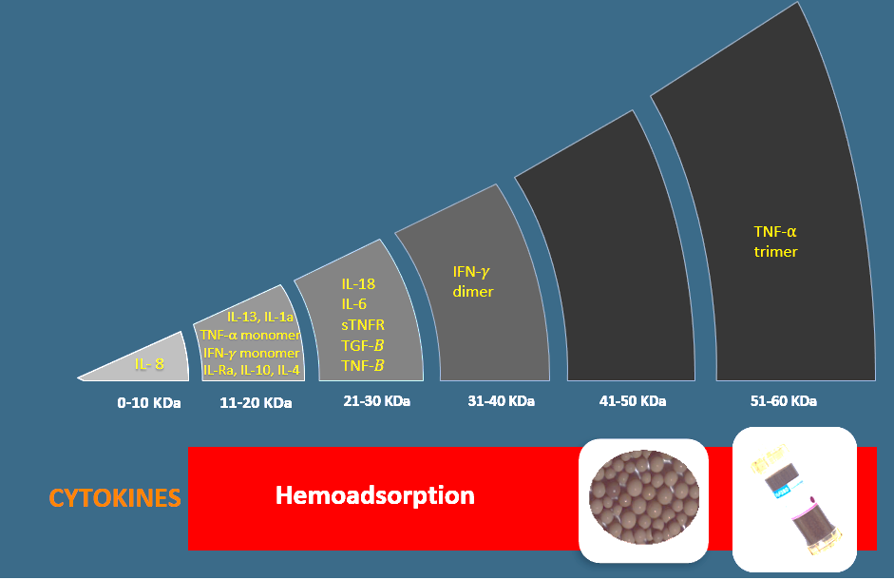
Mechanism of action for HA380
Model | Targeted toxins | Targeted Molecular Weight | Adsorption surface m²
HA380 | Cytokines | 10kDa-60kDa | 54,000~60,000
Molecular Sieve:
Aim Molecular Range：10kDa-60kDa
Hydrophobicity
Physical adsorption/Van der Waals

Slide 11
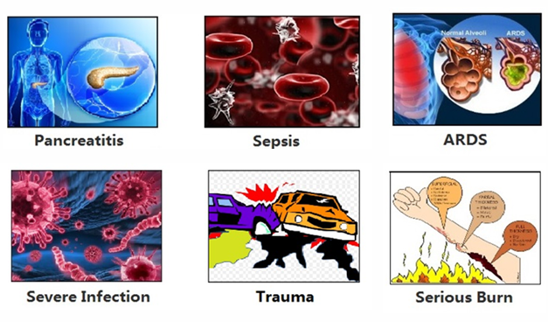
HA380 Hemoperfusion
Targeted Departments:
Intensive care Unit (ICU)
Cardiac Surgery Department
Indications:
Sepsis/septic shock
Covid-19
Cardiac surgery
Severe Acute Pancreatitis
HA380
For Critical Care
Regimen:
3-5 cartridges for 3 consecutive days
The regimen Could be adjusted according to the patient’s situation

Slide 12
Indications of HA380
SEPSIS/SEPTIC SHOCK
1

Slide 13
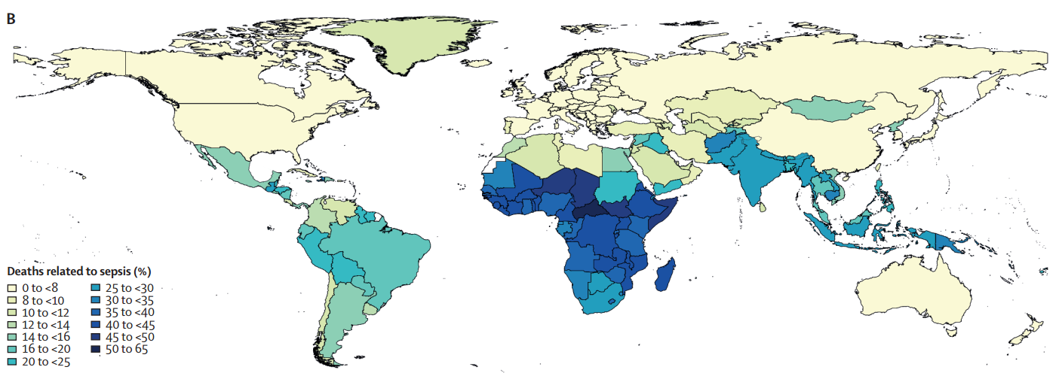
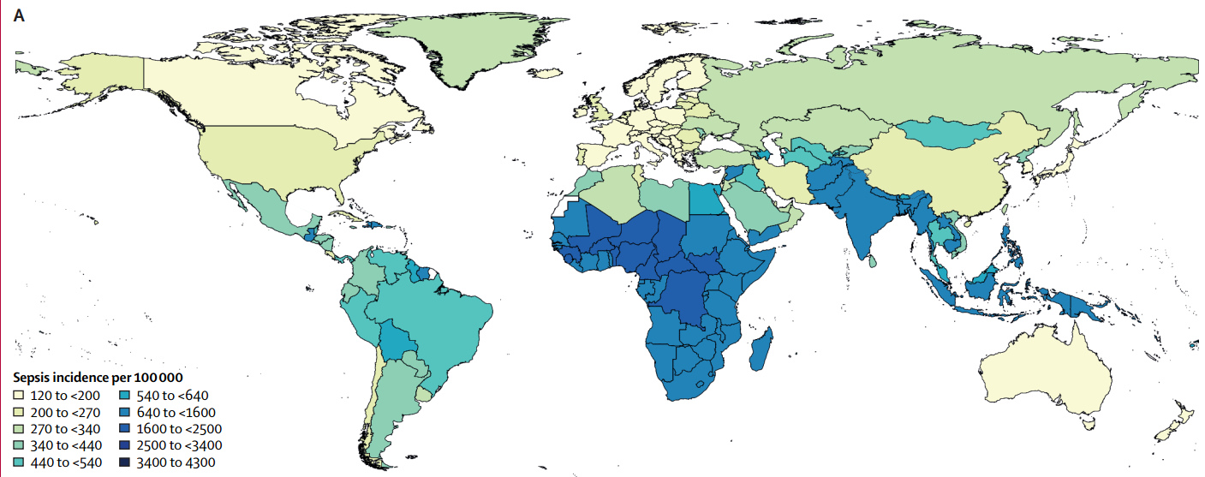
sepsis statistics
Incidence and Mortality: in 2017, an estimated 48·9 million incident cases of sepsis were recorded worldwide, and 11·0 million sepsis-related deaths were reported, representing 19·7% of all global deaths.
Lancet 2020; 395: 200–11, DOI: https://doi.org/10.1016/S0140-6736(19)32989-7

Slide 14
HA380 for sepsis
Indications： Patients diagnosed in septic shock according to Sepsis-3 diagnostic criteria High levels of inflammatory markers (PCT/CRP) Patients’ Plasma levels of IL-6 > 5 folds normal level
Septic shock
Adult patients with sepsis
Hypotension
Requiring vasopressors to maintain a mean arterial pressure (MAP) of 65 mmHg or greater
Blood lactate ≥ 2mmol/L after
Regimen： 3-5 cartridges for 3 consecutive days
The regimen Could be adjusted according to the patient’s situation
Notes:
Sepsis is the main reason for infectious death worldwide. It is estimated to affect at least 18 million patients worldwide, and the mortality rates of sepsis is around 25%-30%. To raise awareness of Sepsis, World Sepsis Day is created on September 13th yearly since 2013.

Slide 15
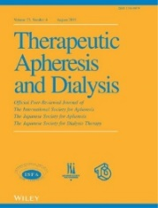
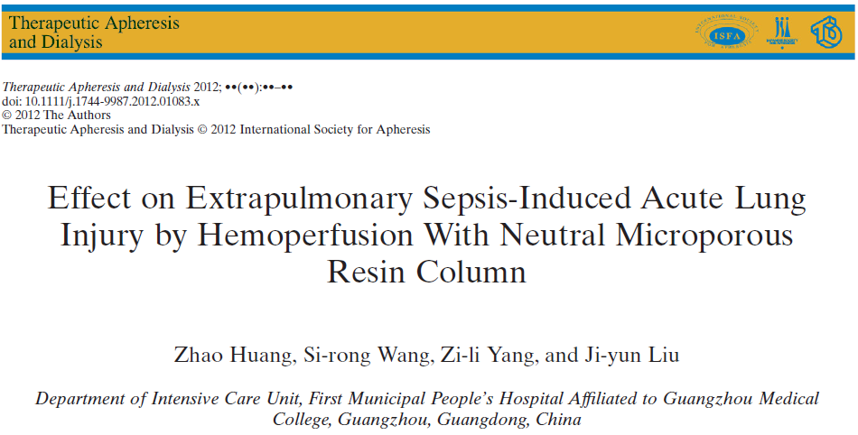
HA380 for sepsis
Design：
A prospective randomized, parallel controlled analysis.
N=46
Control=21
HP=25;
HP: HP once a day for three consecutive days
Follow-up：28 days
Cytokines Removal
Notes:
There were no significant differences of the etiology of infection in the patients between the 2 groups. And they from the result that after 7 days treatment IL-6 and TNF-a of HP group had a more acute and obvious reduction that the control group， and presented a significant reduction over time.
On the other hand, they found better effect on oxygenation, mechanical ventilation , creatinine and hemodynamics of hemoperfusion treatment. Such as the dosage of dopamine in the Control group it cost 16, but in HA group it just cost 5 . And after 7 days, the creatinine of HP group is less than half of that in control group. So this data apparently showed that HP could effectively improve organ function and hemodynamic of sepsis patients.

Slide 16
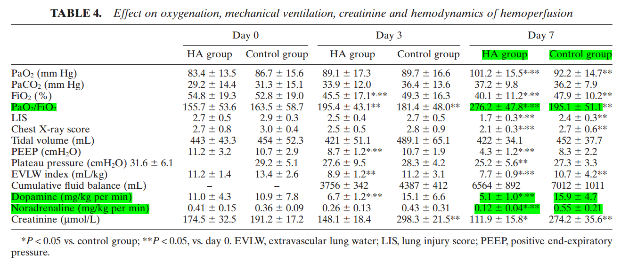
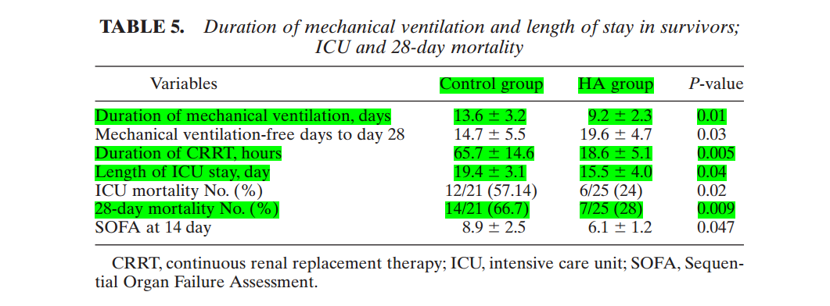
HA380 for sepsis
improving respiratory dysfunction Reducing Vasopressors needs
Significantly reducing the: Mechanical ventilation time ICU stay Disease severity 28-days mortality
Zhao Huang et al. Therapeutic Apheresis and Dialysis, 2012: 1744-9987
Notes:
Besides, they found that patients with hemoperfusion treatment had just 24% ICU mortality while that of control group is up to 57%. So as the 28-day mortality.

Slide 17
HA380 for sepsis
N=11 :no response to the septic shock treatment characterized with
1- Use of high-dose vasopressor or dual vasopressor
2- Dysfunction of 2 organs ≥
3- Presence of suspected or proved gram-negative infection.
Methods:
HP treatment once a day for 3 consecutive days;
HP for first 2h, continued with CVVH treatment.
Follow-up：28 days

Slide 18
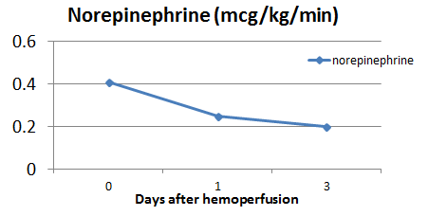
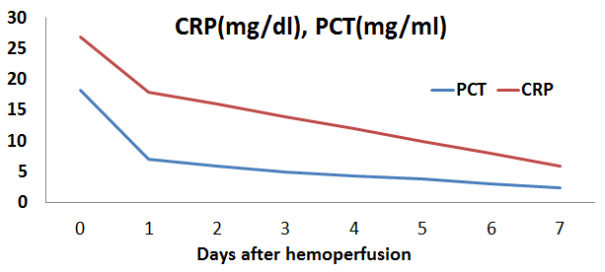
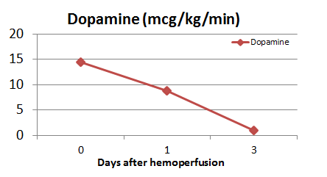
HA380 for sepsis
Results:
28-day hospital mortality rate of the present study was recorded to be lower than the mortality rate estimated by the APACHE 2 score 63.4vs 73.3%.
Reduce inflammatory markers:
CRP and procalcitonin values decreased after the treatment
Decrease vasopressor needs decreased by 40% within the first 24 hours

Slide 19
Indications of HA380
2
Covid -19

Slide 20
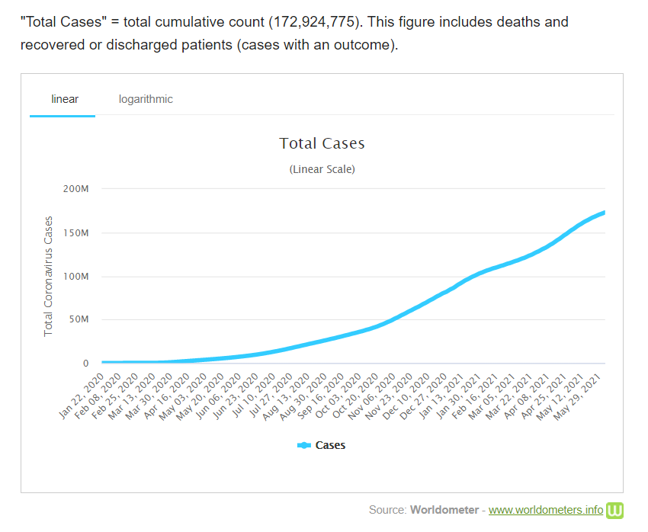
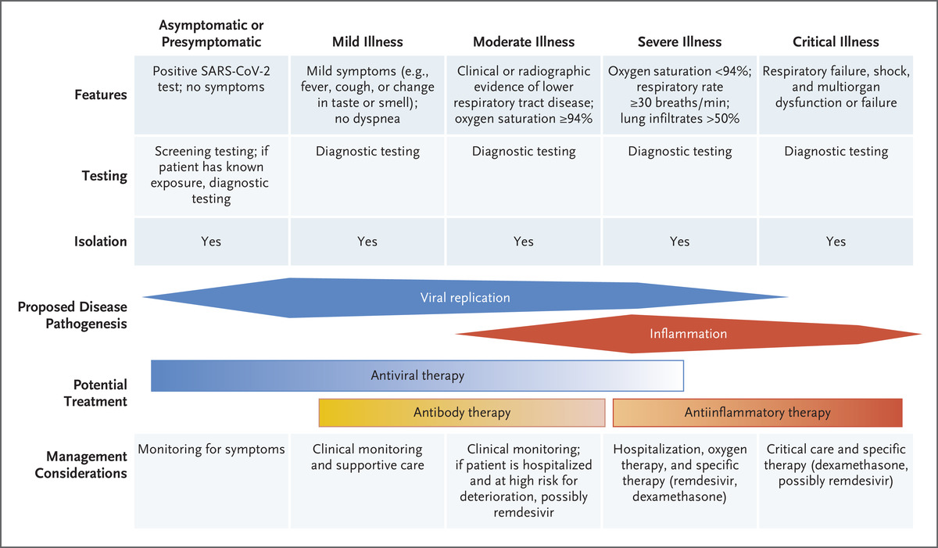
Coronavirus statistics
Coronavirus disease 2019 (COVID-19): is defined as illness caused by severe acute respiratory syndrome coronavirus 2 (SARS-CoV-2)
Gandhi, Rajesh T., John B. Lynch, and Carlos Del Rio. "Mild or moderate Covid-19." New England Journal of Medicine 383.18 (2020): 1757-1766.
Last updated: June 04, 2021, 08:23 GMT

Slide 21
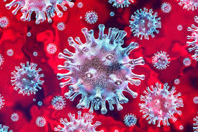
HA380 for COVID-19
The HA330/HA380 device is aimed to treat patients 18 years of age or older with confirmed COVID-19 admitted to the ICU with any one of the following conditions:
Early acute lung injury (ALI)/early acute respiratory distress syndrome (ARDS); or
Severe disease, defined as:
dyspnea,
respiratory frequency ≥ 30/min,
blood oxygen saturation ≤ 93%,
partial pressure of arterial oxygen to fraction of inspired oxygen ratio < 300, and/or
lung infiltrates > 50% within 24 to 48 hours; or
3) Life-threatening disease, defined as:
respiratory failure,
septic shock, and/or
multiple organ dysfunction or failure.
Regimen:
Covid-19: 2 HP treatments for 1st day, once HP on 2nd and 3rd day.
The regimen Could be adjusted according to the patient’s situation

Slide 22
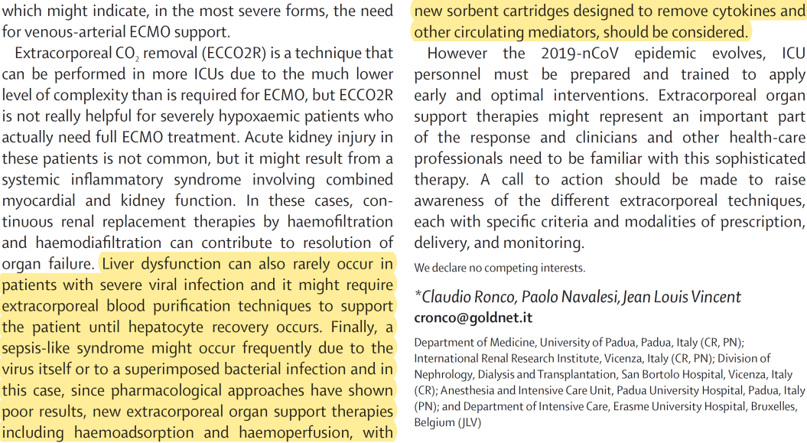
HA380 on covid-19
Guidelines and Experts Recommendations
Prof. Claudio Ronco
Prof. Jean-Louis Vincent

Slide 23
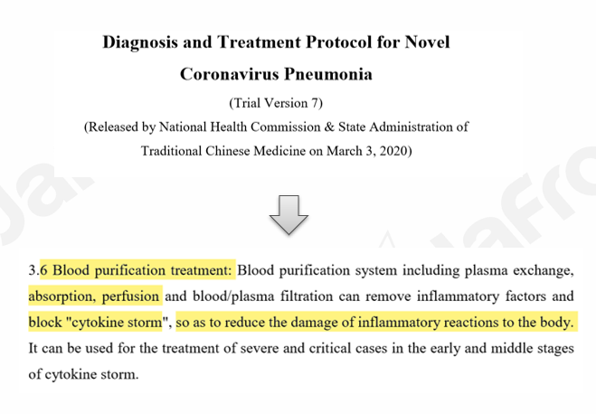
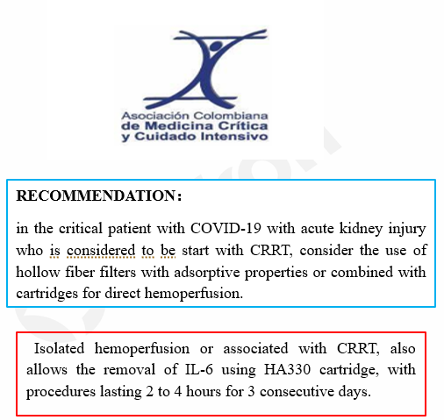
HP on covid-19
Guidelines and Experts Recommendations

Slide 24
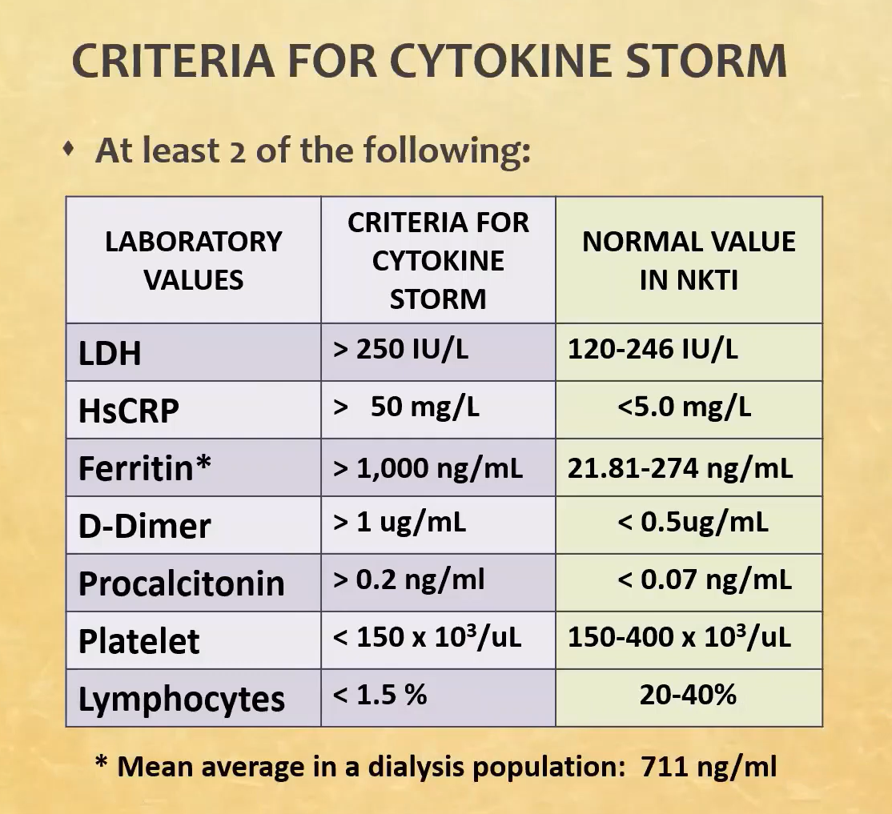
HA380 for COVID-19
Key points to select COVID-19 patients

Slide 25
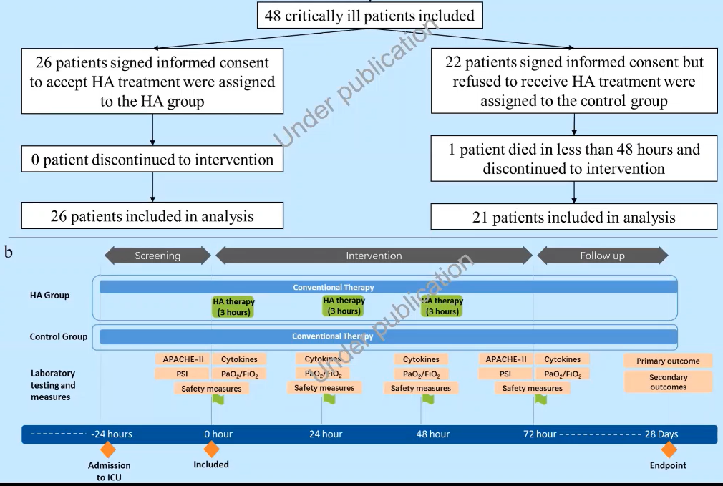
HA380 for COVID-19
HP group: n=21
Control group: n=26

Slide 26
Ha380 for COVID-19
Cytokine Reduction
Oxygenation Improvement

Slide 27
HA380 for COVID-19
Reduce Mortality
Under publication
*Variables had significant difference between the two groups.
ICU = intensive care unit, IPPV = intermittent positive pressure ventilation, ECMO = extracorporeal membrane oxygenation

Slide 28
HA380 for COVID-19
Improve Oxygenation
Reduce Cytokines
Lung regression

Slide 29
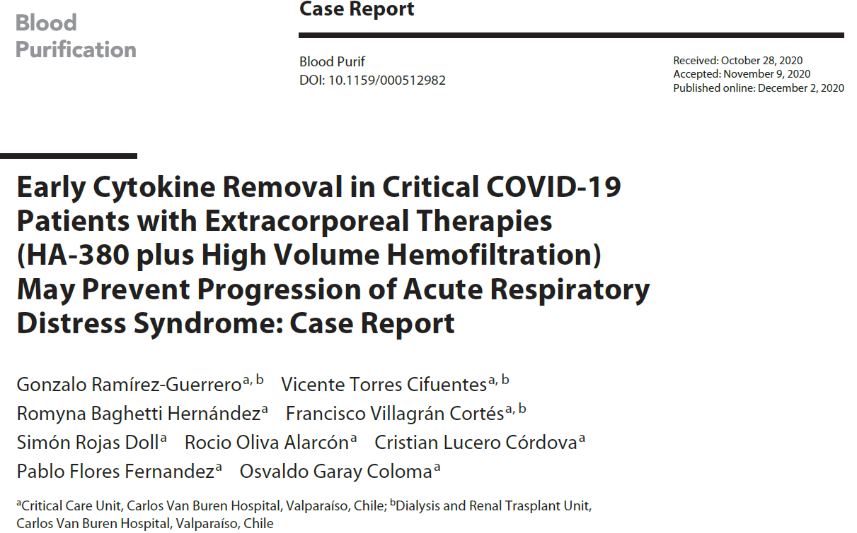
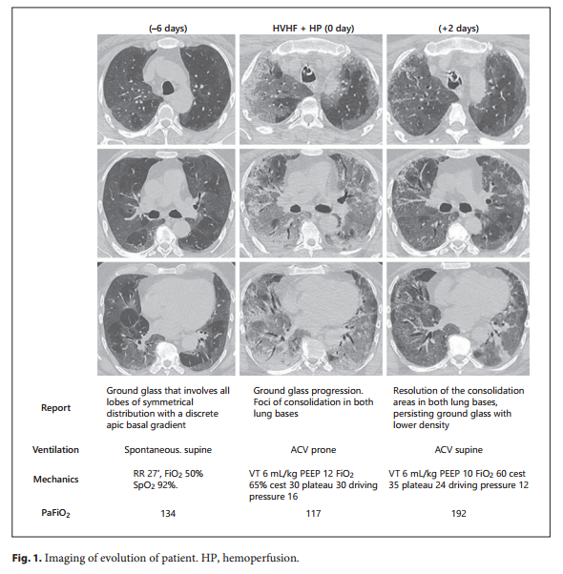
HA380 for COVID-19
Lung regression
Before HP
After HP
A 59-year-old, ARDS COVID-19, cytokine release syndrome
A hemoperfusion (HP) of 10 h (HA-380 cartridge, Jafron Biomedical Co.) was performed combined with HVHF
RESULTS
Normalization of the temperature
Reduce vasoactive drugs requirements
Significant regression of CT images was observed
No adverse events associated with the procedures
Patient died caused by second onset of infection

Slide 30
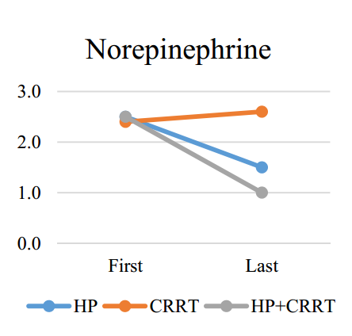
HA380 for COVID-19
Method:12 adult patients who required mechanical ventilation and had (PaO2/FiO2) under 150 with a confirmed COVID-19
HP (HA380 cartridge ): n=2
CRRT group : n= 4, (CRRT)+tocilizumab.
HP (HA380 cartridge )+CRRT group: n=6
Results
Patients in the HP+CRRT group demonstrated a marked improvement in IL-6 and IL-8 levels.
The overall mortality : 66.6% (8 out of 12 patients). HP group (n=2) :50%
CRRT group (n=4): 100% HP+CRRT group (n=6): 50%
The HP+CRRT group had the best overall primary and secondary outcomes.
Reduce the vasopressor requirements

Slide 31
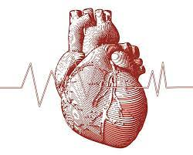
Indications of HA380
3
Cardiac surgery

Slide 32
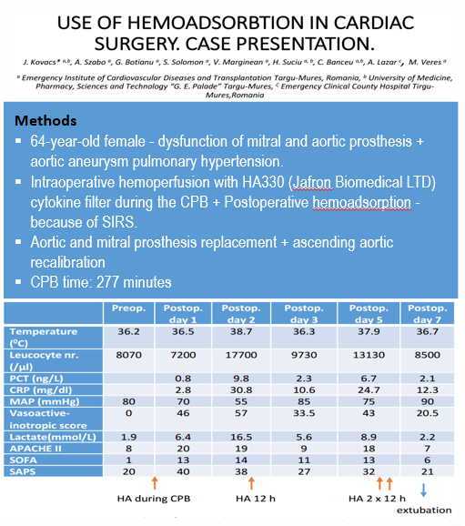
Ha380 for Cardiac surgery
Results: (CPB + HP)
Cytokine adsorber ↓ severity of SIRS + improve hemodynamic condition
Hemodynamic stability, better lab findings and low inotrope use when adding HP.
Trend to reduce the hospital mortality

Slide 33
Indications of HA380
4
ACUTE PANCREATITIS

Slide 34
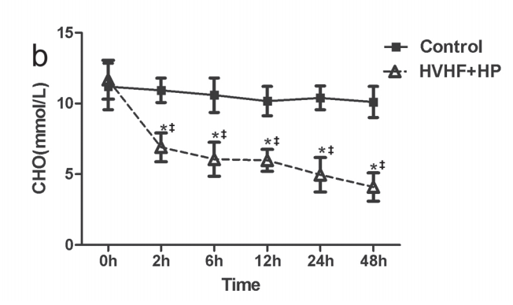
HA380 f0r sever acute pancreatitis
Cytokine removal
、
N=20
Control: conventional treatment
HVHF&HP: in two cycles，24 hours of HVHF + 2 hours of HP each cycle
Lipids’ reduction
After the HVHF&HP:
Significant reduction in serum triglyceride and cholesterol
Significant reduction serum cytokines
- APACHE II score, SOFA score significantly reduced
Significantly shorter ICU stay (P=.015).
Notes:
1 mmol/L = 18.0182 mg/dL

Slide 35
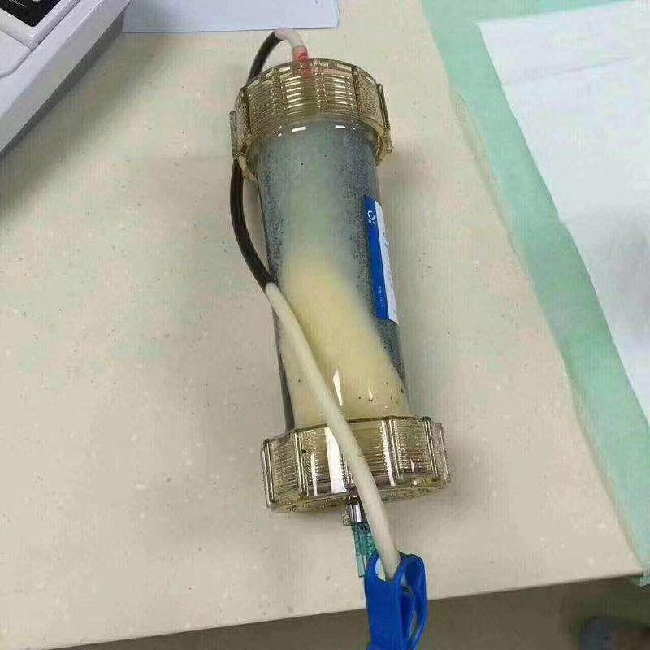
HA380 f0r sever acute pancreatitis
Hyperlipidemia induced pancreatitis
TG levels before and after D1,D2 and D3 of HP therapy
Accumulation of lipids in the Cartridge post adsorption therapy

Slide 36
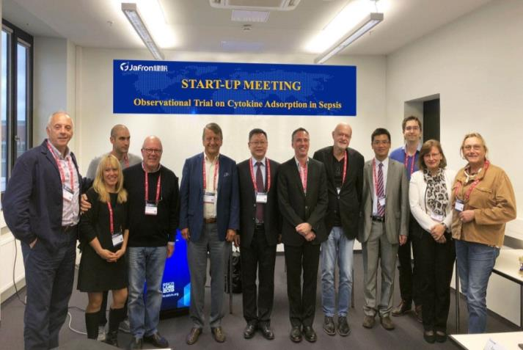
Ongoing trials
Observational Trial on Cytokine Adsorption in Sepsis (OuTCASt)
PI Center:
Aachen University Hospital
Sample Size:
100 patients
Product and Indication:
HA380 for Sepsis
Primary outcome：
Cytokine variability of IL-6 , IL-8- IL-10, and TNF-alpha
Secondary outcome：
Vasopressor / lactate dose, P/F ratio and SOFA score

Slide 37
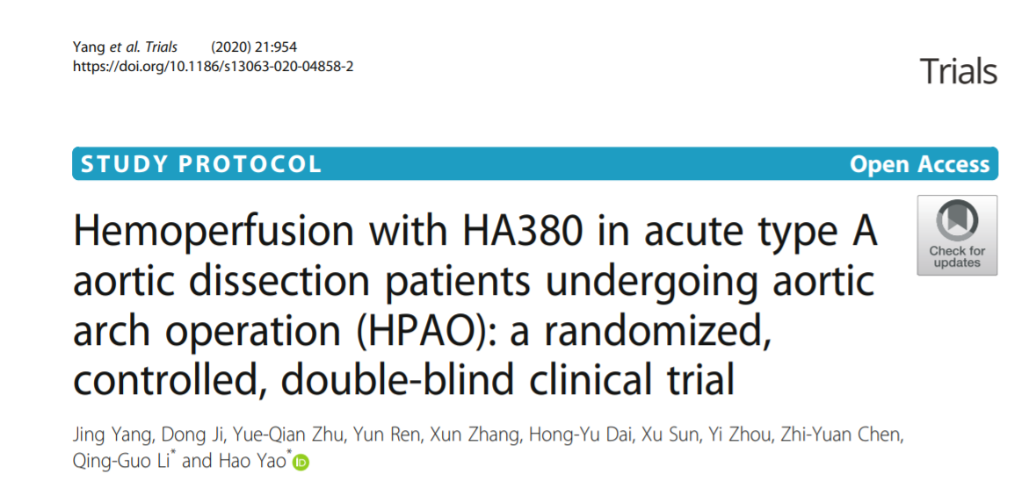
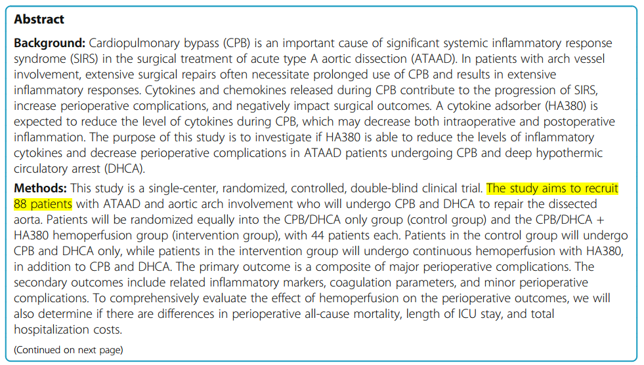
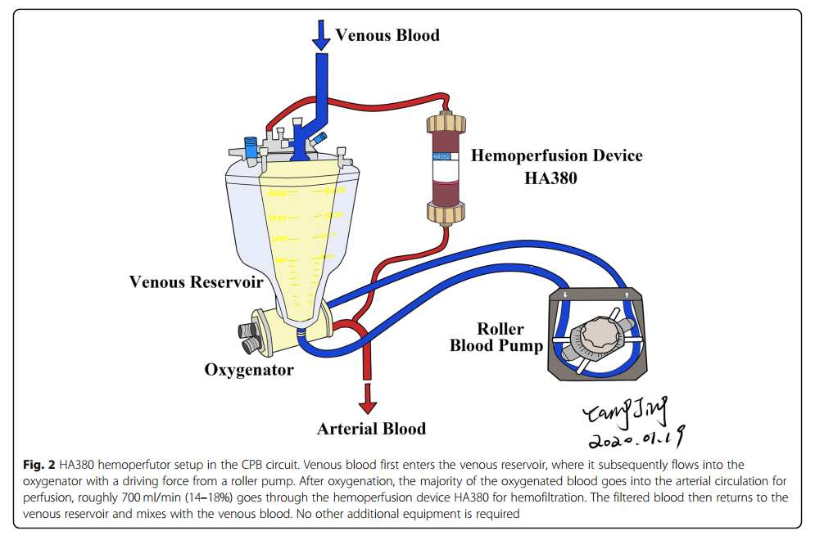
Ongoing trials
https://doi.org/10.1186/s13063-020-04858-2

Slide 38
3
Operation

Slide 39
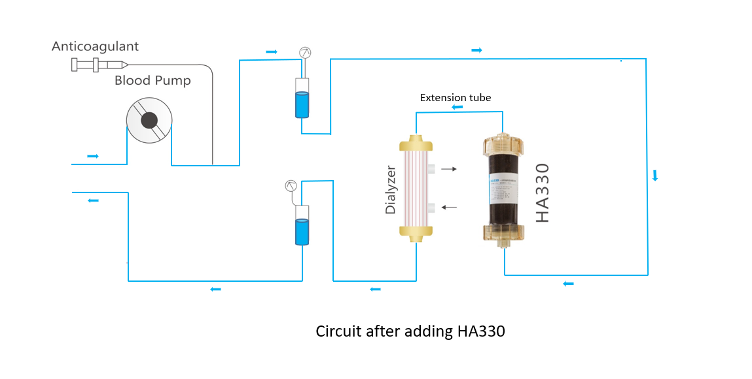
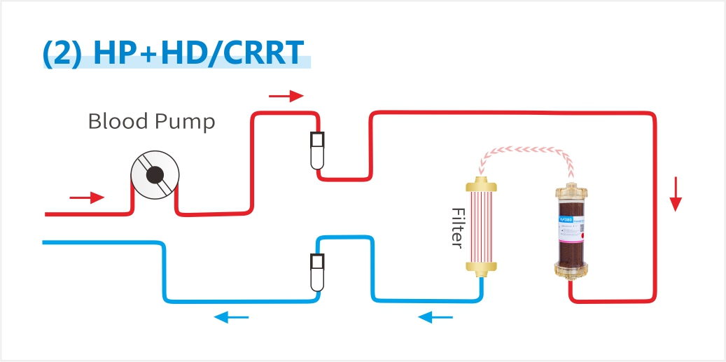
Operation of HA380
Heparinization
By injecting 12500u of heparin into the cartridge
2. Priming
3. Connecting to patient
Prime the cartridge with 3L of saline
Connect the circuit to the patient and initiate the therapy
* Anticoagulation: Heparin, LMWH, Citrate

Slide 40
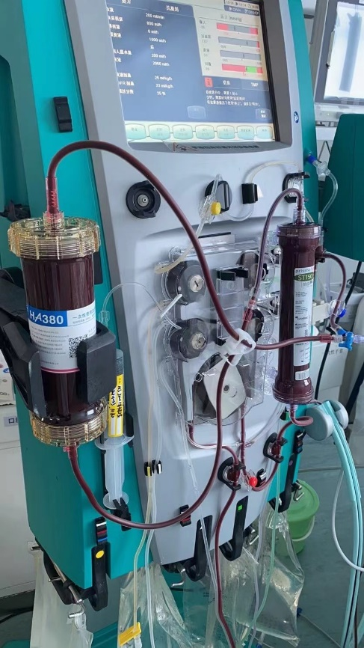
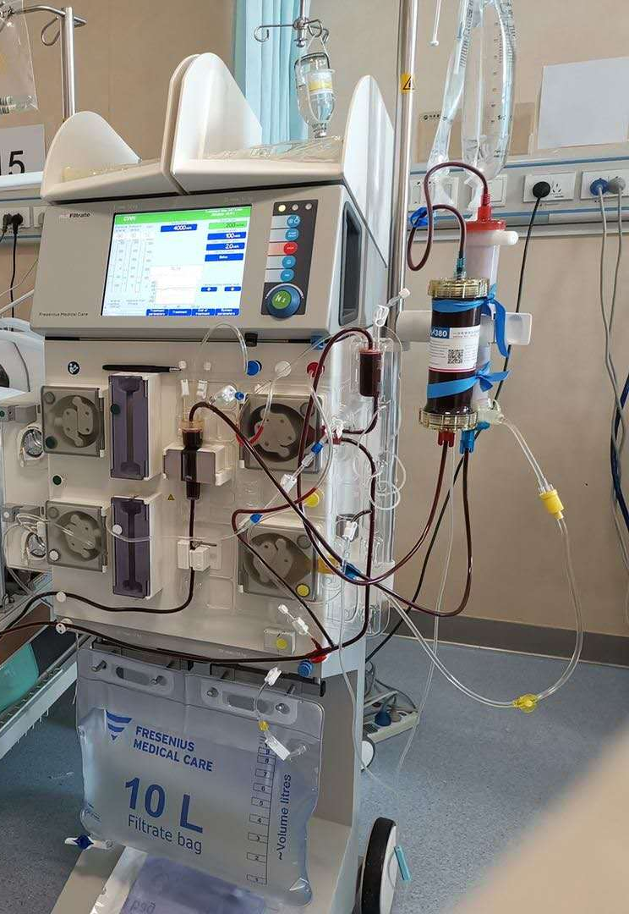
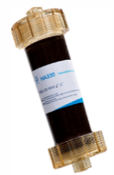
HA380+CRRT Treatment: Connection
Arterial line – HA330 — Extension tube – Filter – Vein line
Arterial line – Filter - Tube C-- HA330 — Tube B –– Vein line
General Machines
Pismaflex Machine
General machines: before the filter
Prismaflex machines: after the filter

Slide 41
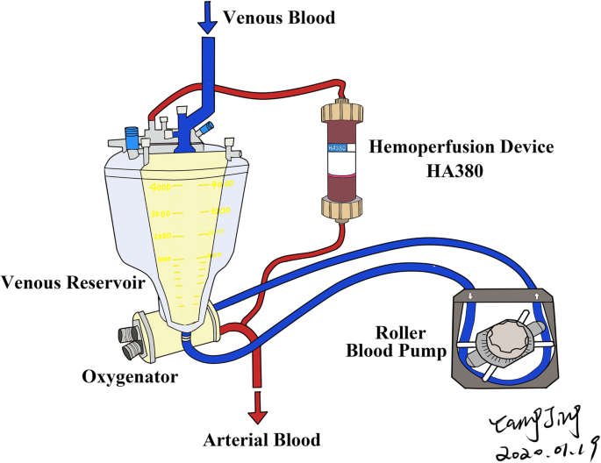
HA380 connecting to ECMO/CPB
Connect HA380 to CPB/ECMO by lateral circuit (not at the mainstream)
The inlet of the cartridge is connected after the oxygenator
The outlet of the cartridge is connected before the blood reservoir or the pump.

Slide 42
Final words
Remove Cytokines
Mediate inflammatory response
Reduce endothelial injury
Improve hemodynamic; Reduce the need for the vasopressor; Benefit organ function;
Reduce the ICU stay; improve survival.

Slide 43
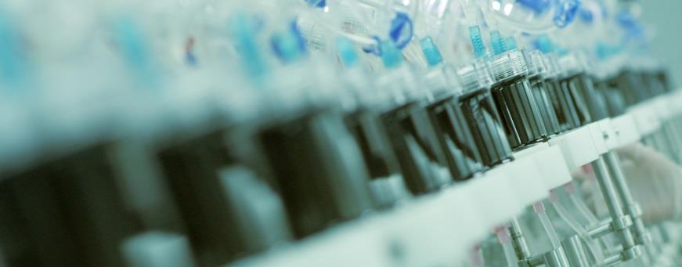
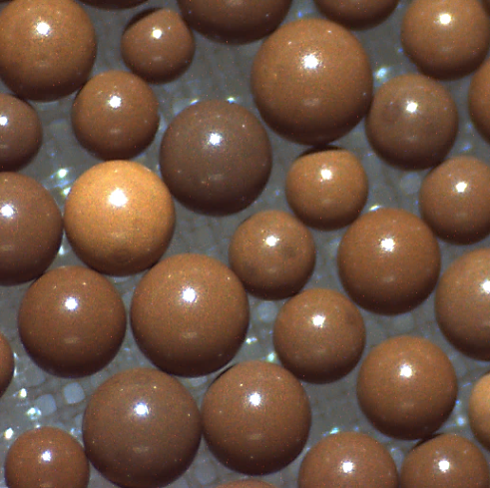
Jafron: make every resin with best quality
Contact Us:
+86 (756) 3689 708
en.jafron.com
support@jafron.com
98, Technology Six Road, High-Tech Zone, 519085, Zhuhai, China

