Slide 1
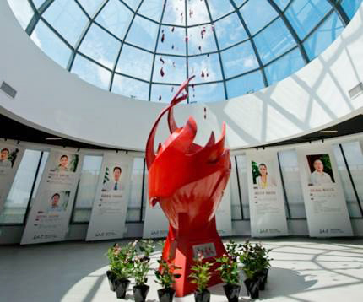
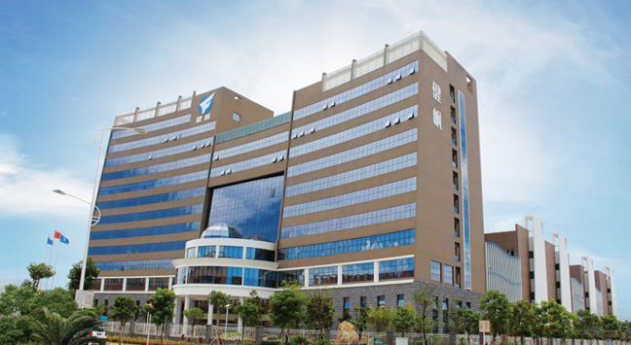
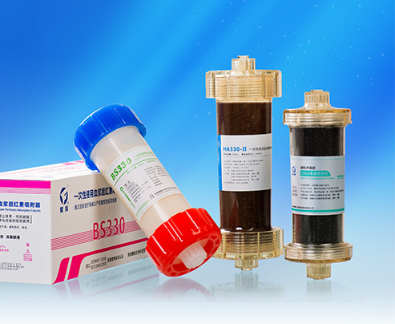
HA230、HA280 AND DNA230 IN HEMOPERFUSION

Slide 2
1
Background of Poisoning
2
Principle and benefits of HA230
3
Clinical studies
4
Operation of HA230
5
Introduction of HA280 and DNA230
Notes:
My introduction will be divided into foour parts: the background of poisoning, Principle of HA230, and some clinical studies of HA230 application in different poisoning. and operation of HA230

Slide 3
1
Review and Validation of potential papers / Case reports from other countries important for us eg Turkey etc.. All member, (John, schenider Thomas ,olivier)
2
Hemoperfusion in terms of protocols vs different specialities ( Surgical / Trauma(john prowle) / Burn (Thomas,schneider )/ Paediatric(ricci,italy) ) with HA 380 all of them.
3
Validation of our tutorials ( booklet scheneider,Olivier,– Video,ronco, ) and corrections if necessary
4
Get proposal in terms of Webinars themes like pro /Con(all of them)

Slide 4
1
Background of
Poisoning
Notes:
so lets take a look at some background of poisoning first

Slide 5
1
POISONING OVERVIEW
Part
Annual estimated number and percentage of suicides in each WHO region (2010-2014)
WHO Region | Total no. suicides (World Health Organiation, 2014) | Estimated % of suicides due to pesticide poisoning in the region | Estimated no. pesticide suicides | % of each region's population contributing to the estimate
High-income countries | 192000 | 1.7 | 3300 | 89.7
African Region | 61000 | 3.5 | 2100 | 5.9
the Americas | 35000 | 8.8 | 3100 | 95.7
Eastern Mediterranean Region | 30000 | 7.1 | 2100 | 33.4
European Region | 35000 | 0.9 | 300 | 56.2
South East Asia Region | 314000 | 11.3 | 35500 | 69.1
Western Pacific Region | 131000 | 48.3 | 63300 | 92.3
Total | 798000 | 13.7 | 109700
The global burden of fatal self-poisoning with pesticides 2006-15: Systematic review
World Health Organization, 2014
Notes:
According to official statistic globally, the acute poisoning is mainly caused by pesticide, industrial toxin, drug overdose, biotoxin and others.
The global poisoning causes are similar, but the proportion of these causes of poisoning are different according to different regional conditions.
According to the table, we could found that the total amount of global pesticide death is nearly 110 thousand cases per year. Especially in Africa and South East Asia or even in Eastern Mediterranean, South America, there are many people suffering from pesticide.

Slide 6
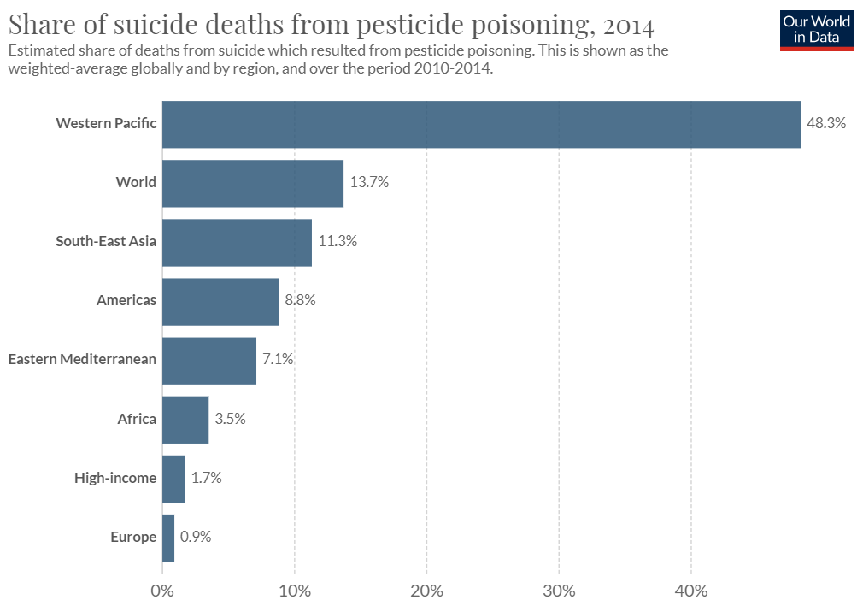
1
POISONING OVERVIEW
Part
Notes:
According to official statistic globally, the acute poisoning is mainly caused by pesticide, industrial toxin, drug overdose, biotoxin and others.
The global poisoning causes are similar, but the proportion of these causes of poisoning are different according to different regional conditions.
According to the table, we could found that the total amount of global pesticide death is nearly 110 thousand cases per year. Especially in Africa and South East Asia or even in Eastern Mediterranean, South America, there are many people suffering from pesticide.

Slide 7
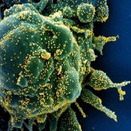
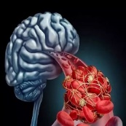
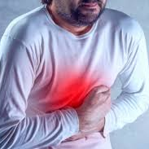
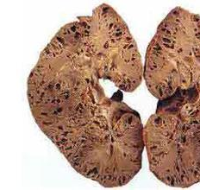
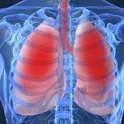
1
CONSEQUENCE OF POISONING
Part
Cells destruction
or death
Tissue hypoxia
and ischemia
Hallucinations
Respiratory depression
or apnea
CONSEQUENCE
Severe organ injuries
Renal failure
Other fatal
complications
Pulmonary edema
Notes:
Poisoning may destroy or even kill the cells and lead to tissue hypoxia or even severe organ injuries such as pulmonary edema, renal failure.
Besides, the central nervous system will be affected, patients will have hallucinations. And many other fatal complications will be induced.

Slide 8
1
Factors affecting the prognosis of poisoning
Part
Due to
treatment
Due to
individuality
Product 02
The toxicity of poisons
Transportation
The dosage of poisons
Distribution
The treatment time
Metabolism
Early effective measures
Excretion
Different time to use the same treatment method
may lead to absolutely different effects.
Notes:
So after the treatment, two factots will affect the pronosis of poisoning.
Treatment and individuality.
Treatment effectioon depends on the

Slide 9
1
ACUTE POISONING CONTROL
Part
Therapeutic Principles
Weakness
Stop contacting the poisons
No specific antidote
?
Clean the undigested poisons in vivo
Unknown or multiple drugs mixed
Fasten the excretion of poison
Before definite diagnose
Apply specific antidotes
Poor efficacy
Related Symptomatic treatment
Side effect
Notes:
The basic clinical method for poisoning are 5 as follows. We usually stop the contacting of poisons, scavenge the undigested poisons in vivo, fasten the excretion of poison, apply the specific antidotes and other related Symptomatic treatment.
Actually, there are some problems in clinical practice. For some poisons, we do not have specific antidote and make no sense of the drugs.
Before definite diagnose, we could not conduct accurate treatment. And these basic method has poor efficacy and slow effect which may worsen the patients’condition.

Slide 10
1
BLOOD PURIFICATION
Part
Small water soluble substance
Methanol,
ethylene glycol,
lithium
Hemodialysis
（HD）
2
Plasma Exchange （PE）
All kind of toxin in blood
Disadvantage:
Dose effect relationship
Infection
1
Hydrophobic
Middle to large molecules
Hemoperfusion （HP）
3
4
（HF）
Hemofiltration
Water soluble substance
Small molecules
Part of medium molecules
Notes:
So is there any other way to treat poisoning?
There are some Blood purification methods commonly used in clinical practice such as HD, HF,PE,HP are common used for poisoned.
PE could directly remove the toxins from the blood but has its disadvantages such as high risk of infection.
HP is designed to remove hydrophobic substances.
And hydrophobicity is the typical characteristic of the most poisons.

Slide 11
2
Principle and benefits of
HA230
Notes:
SO how does our HA230 work?

Slide 12
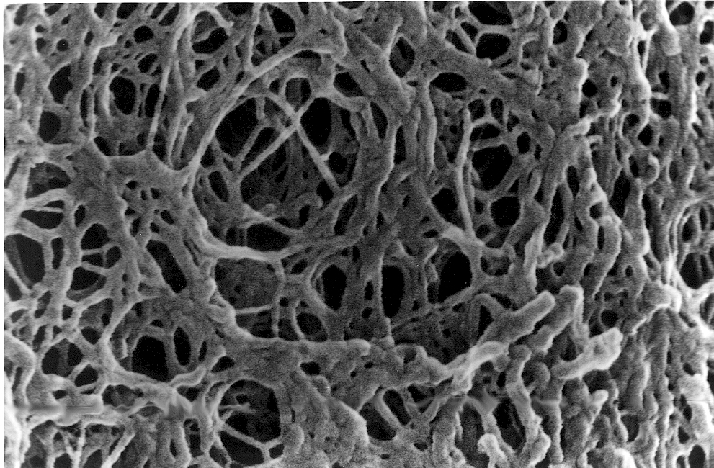
2
HA230 Hemoperfusion Cartridge
Part
Hydrophobicity
Molecular Sieve
Physical adsorption/Van der Waals
Electrostatic interaction
Notes:
This is the HA230 hemoperfusion cartridge. Inside the cartridge are the resin showed as brown bead. And under the Electron Microscope we can see the inner surface of the resin with the 3D network structure works as the molecule sieve.
Based on the principle of hydrophibility and interactions, when the blood goes through, it only the specific toxins will be adsorbed.
So that is the mechanism of HA230.

Slide 13
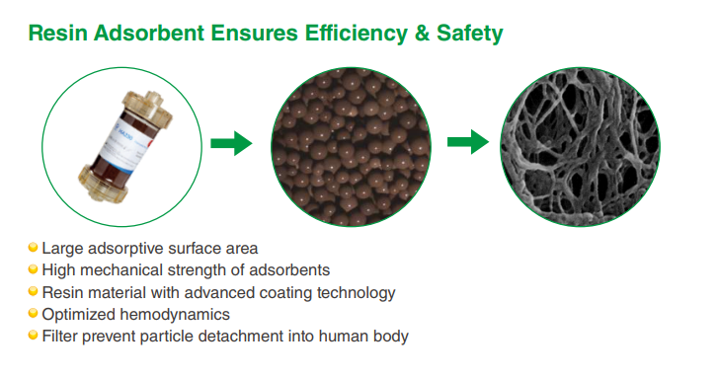

Slide 14
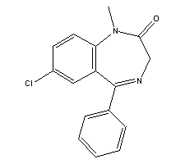
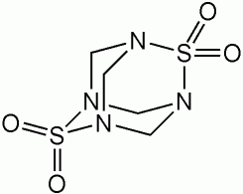
2
Hydrophobic Structure
Part
Morphine
Cocaine
Dopamine
benzene ring
Pentobarbital
Diazepam
Tetramine
Drugs with organic ring in the molecular structure are easily adsorbed.
Notes:
Especially, drugs with organic ring in the molecular structure are easily adsorbed. Such as Morphine with benzene ring.

Slide 16
2
HA230 Indications
Part
Digoxin
Cytostatics
Notes:
Based on the principle we talked above, HA230 hemoperfusion cartridge can be used for poisoning caused by pesticide, Biotoxin, drug overdose...etc
For example, in India, Snake bite is the most common indication ，and In Germany, a new indication has been developed, using HA230 for cancer patients to remove excessive cytostatics to relieve complications of chemotherapy.

Slide 17
2
Comparison of Charcoal & Resin
Part
Materials | Charcoal | Resin
Adsorbents | Activated charcoal | Neutral macro-porous resin
Mesh size | Unselective | 13~15nm (selective)
Property | None-selectivity | Relative specificity
Aim substance | Small to middle molecules | Middle to macro molecules Protein-bound molecules
Security | 1.Harmful to blood cells 2.Poor bio-compatibility 3.Weak skeleton: easily break off and form embolism | 1.Smooth surface 2.Good bio-compatibility 3.Strong skeleton
Application | Widely use in poisoning | Poisoning, immune disease, liver disease, renal failure…
Notes:
lets compara another adsorbent charcoal with resin.

Slide 18
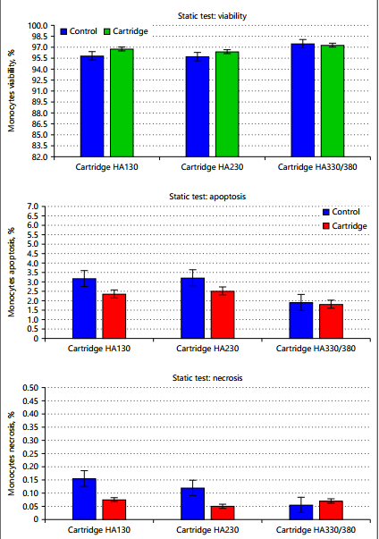
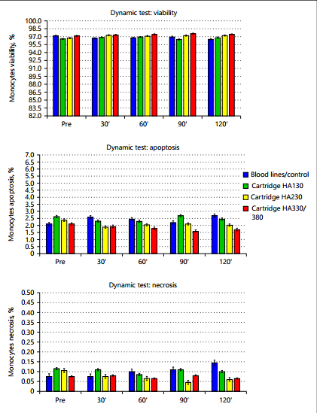
Safety: Lab monocyte test
Results
No evidence of increased necrosis or apoptosis in monocytes exposed to the cartridges both in the static and dynamic tests.
HA cartridges carry an level of biocompatibility and their use in HP is not associated with adverse reactions or signs of cytotoxicity.
Static Test
Dynamic Test

Slide 19
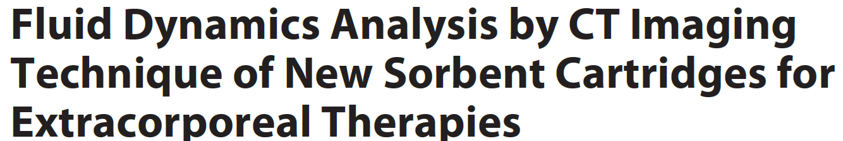
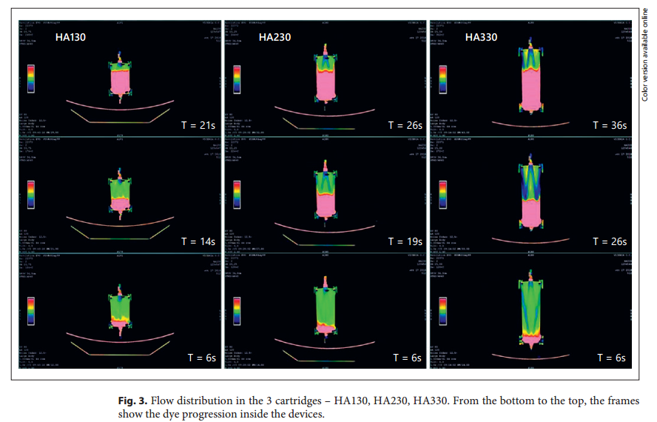
Safety: Radiological results
Results
Sequential images demonstrated an excellent distribution of the flow inside the cartridges.
The structural and functional design of the studied cartridges is adequate for hemoperfusion without channeling phenomena.

Slide 20
3
Clinical studies
Notes:
Let me show you some clinical studies of HA230 application.

Slide 21
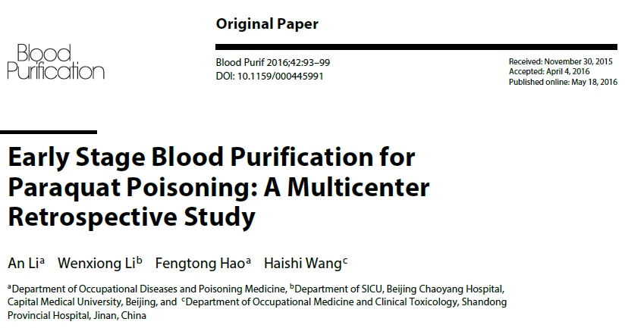
HA230 for Paraquat
Notes:
This is a multicenter retrospective study for paraquat posoning treatment.

Slide 22
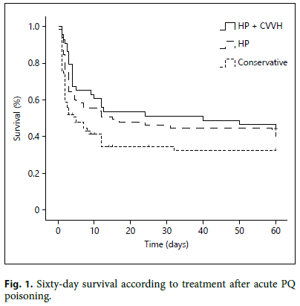
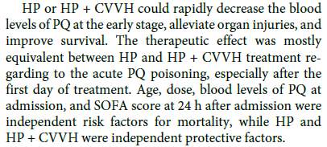
HA230 for Paraquat - Conclusion
Notes:
Apart from that, they found that the 60 day survival post HP+CVVH and HP was largely improved than the conservative group. So they comes to the result that …

Slide 23
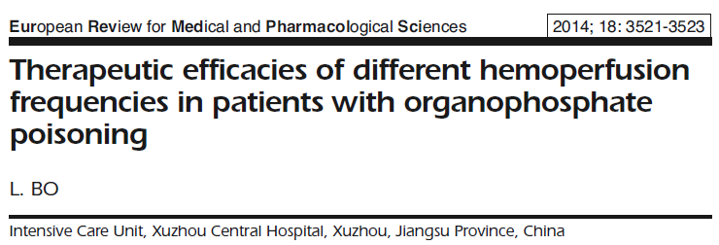
3.2
HA230 for ASOP
Part
Repeated HP Group: n=20 received 3-4 times HP within 48 hrs;
Single HP Group: n=16 received once HP
ASOP= Acute severe organophosphate poisoning
Notes:
Another publication is on the comparison of once HP treatment and repeated HP treatment for acute severe organophosphate poisoning on 1st day. They enrolled 36 patients and divided them into 2 groups. For group 1 with 20 patients who received 3-4times HP within 48 hrs. For group 2 with 16 patients who received once HP treatment.
Acute Severe Organic Phosphorus Poison)

Slide 24
3.2
HA230 for ASOP – Result & Conclusion
Part
IMS: intermediate myasthenia syndrome
Conclusion:
Early repeated HP is more efficient than single HP in treating acute severe organophosphate poisoning.
Notes:
According to the result of treatment efficacies, they concluded that early hemoperfusion is more efficient than single hemoperfusion in treating organophosphate poisoning.

Slide 25
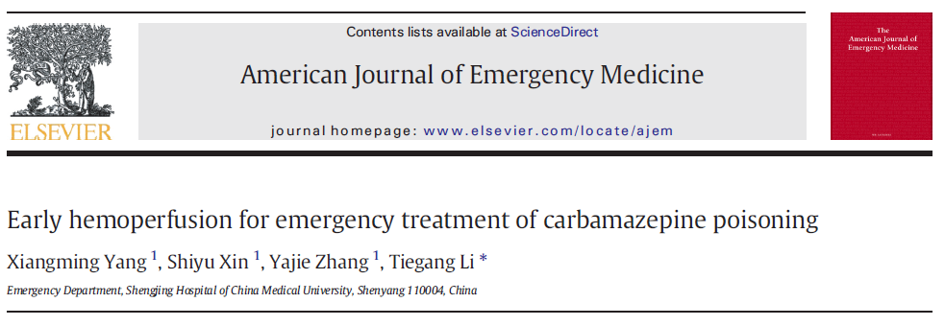
3.4
HA230 for Carbamazepine
Part
104 patients with acute Carbamazepine poisoning
Group A (HP in Emergency Department)=51
Group B (HP in the blood purification room)=34
Group C (No HP)=19
Notes:
group A, who received HP treatment in the Emergency Department; group B, who received HP treatment in the blood purification room; and group C,
who did not received HP treatment.
[,kɑrbə'mæzə,pin]

Slide 26
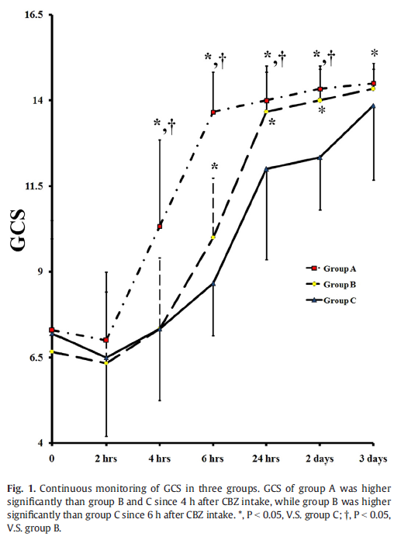
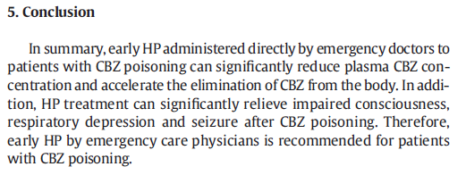
3.4
HA230 for Carbamazepine – Result & Conclusion
Part
Improve the consciousness recovery, survival and shorten the hospital stay day
Glasgow coma score
Notes:
Epileptic seizures
a significant difference in the state of consciousness was seen at 4 h after admission: GCS scores in group A were significantly higher than those of groups B and C (P b 0.05).

Slide 27
3.5
Case Study ：HP for Suicidal Digoxin
Part
From Dr.Deven Juneja, India
Initial condition:
A young female who presented to ER with alleged history of consumption of 17.5 mg of digoxin tablets. After admission to ICU, she developed atrioventricular blocks with hemodynamic instability. 亲脂疏水？
Notes:
And also we are collecting cases globally and tthere are alsp drug overdose cases. let me show you a case study that happened in india

Slide 28
3.5
Case Study ：HP for Suicidal Digoxin
Part
From Dr.Deven Juneja, India
Result
Gradual symptomatic improvement
Heart rate also improved
Atrio-ventricular block got corrected over the next 24 hrs.
Then continue to remain asymptomatic
Discharged after 4 days of hospitalization
High serum digoxin levels
Bradyarrhythmias with hypotension
Non-availability of Fab fragments of antidigoxin antibodies
HP for 4hrs
Conclusion: Resin hemoperfusion may be successfully and safely used as an alternative therapy, in combination with other supportive measures, to manage patients with digoxin toxicity especially when Fab fragments are unavailable.

Slide 29
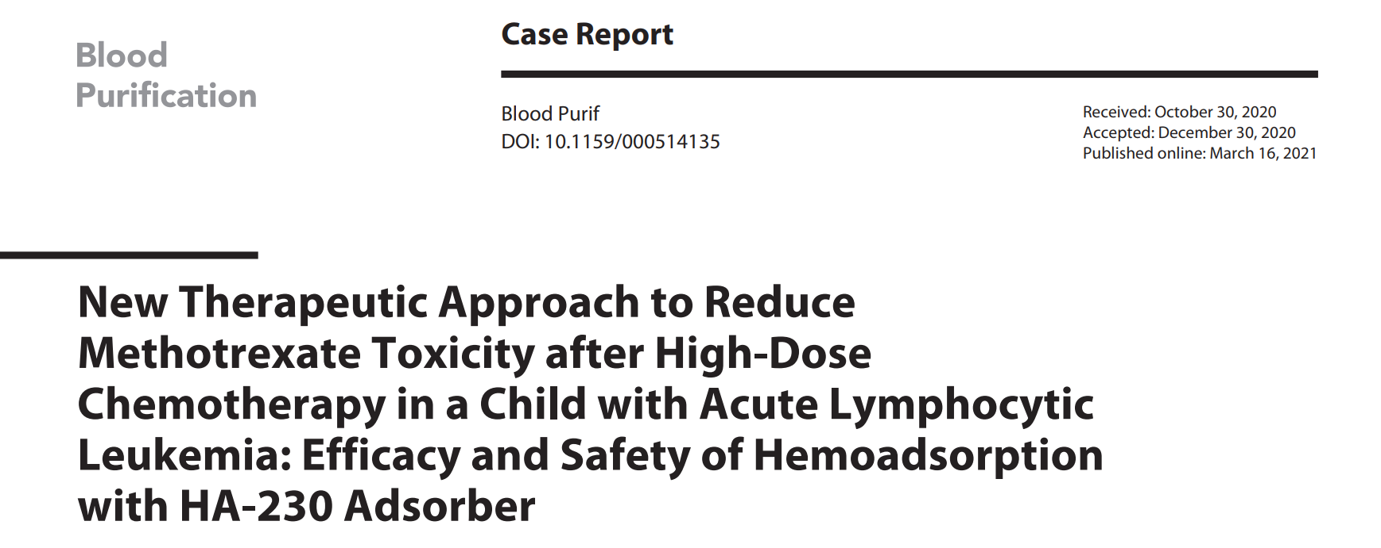
3.2
HA230 for HDMTX
Part
HDMTX:High-dose Methotrexate
Notes:
Another publication is on the comparison of once HP treatment and repeated HP treatment for acute severe organophosphate poisoning on 1st day. They enrolled 36 patients and divided them into 2 groups. For group 1 with 20 patients who received 3-4times HP within 48 hrs. For group 2 with 16 patients who received once HP treatment.
Acute Severe Organic Phosphorus Poison)

Slide 30
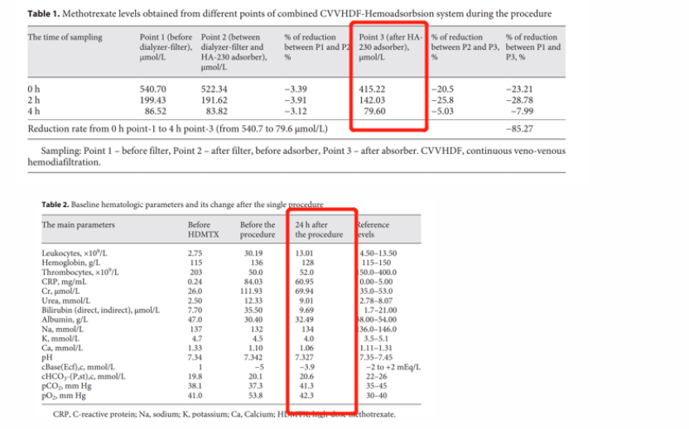
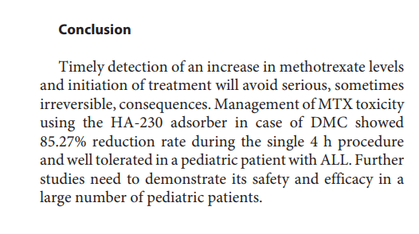
3.8
HA230 for HDMTX
Part
.
Case Report: implementation of HA-230 hemoadsorption procedure to remove cumulated MTX from the body and reduce its toxicity in a child with ALL after high-dose chemotherapy
Notes:
Of course, there are many other indications reported such as acute wasp stings and abrin poisoning.

Slide 31
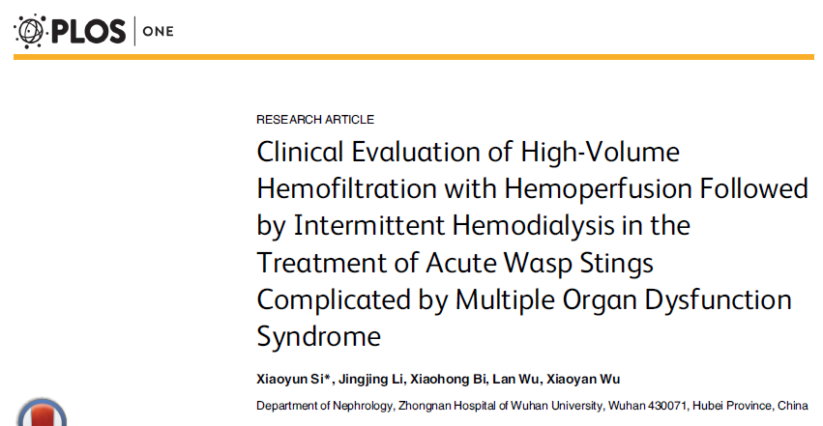
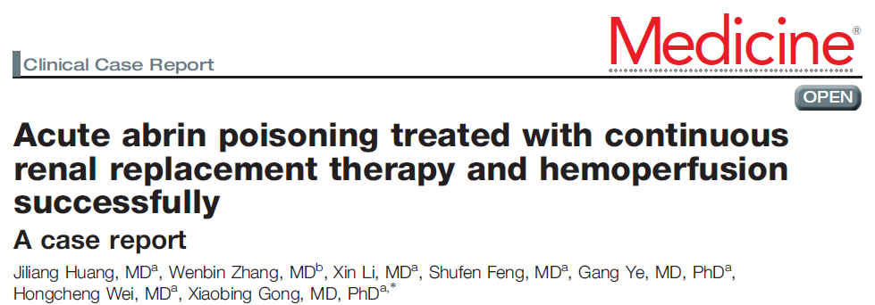
3.8
Other Publications
Part
Acute wasp stings
Abrin poisoning
Notes:
Of course, there are many other indications reported such as acute wasp stings and abrin poisoning.

Slide 32
3
Sum Up
Part
Accelerate poisons elimination
Reduce metabolic substances
Alleviate complications
Keep internal environment stable
Shorten hospitalization
Improve survival
Pesticide & Herbicide
Rodenticide
Biotoxin
Drug overdose
Industrial toxin
Clinical Suggestions:
As early as possible
More frequent HP treatment at beginning(1-3 times/day)
Longer treatment time
Notes:
As we shared such cases of using HA230,lets usm up this part.

Slide 33
4
Operation of HA230

Slide 34
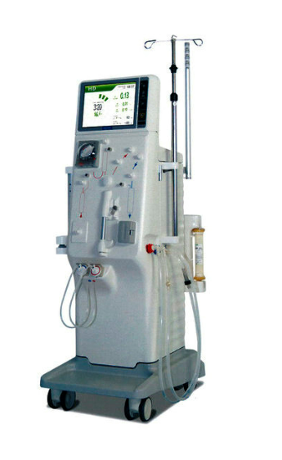
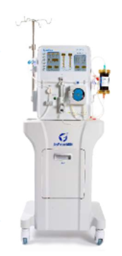
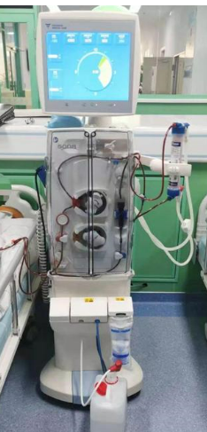
Compatible with All KINDS of MACHINES
CRRT
HDF
JF-800A
Hemodialysis
Notes:
Easy to use

Slide 35
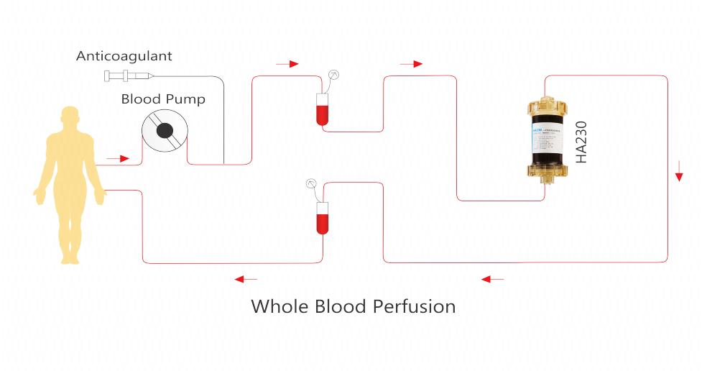
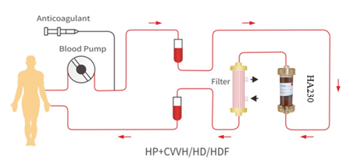
Operation
Recommendations:
Treatment Time: < 6h
Blood flow rate: 100~320 ml/min
Anticoagulant:
Heparin
first-dose: 62.5~125U/kg
additional dose: 1250～2500U/h
Citrate
4% sodium citrate 100-250ml/h input from the artery, keep ACT within 200～250s.
keep free calcium within 0.20-0.40mmol/L in vitro；
1.00-1.20mmol/L in vivo.
Notes:
单独全血灌流，常规 HA230 for Poisoning is commonly conducted by directly blood hemoperfusion singly. And it can be also conducted with other treatment methods such as HD,CVVH.
The treatment time we recommend is less than 6hr. And the blood flow rate is recommended from 0-300. Commonly speaking, the flow rate is around 200ml/min. Heparin and citrate are the common anticoagulants for the poisoned patients. Any treatment parameters could be adjusted according to the actual conditions.
200ml/minjingc
In clinic, we usually set the blood flow rate around 0-300ml/min. The common anticoagulant are heparin and citrate. For heparin, the first dosage is around 62.5-125U/kg and the additional dosage is 1250U-2500U/h. This is the HA230 treatment mode. HA230 could be conducted singly on hemoperfusion machine, hemodialysis machine or single pump machine. Besides it can be combined with HD treatment, HDF treatment or CVVH treatment on related machines when patients have renal injuries. So the operation of HA230 is quite flexible and suitable for emergency cases.

Slide 36
5
Introduction of HA280 and DNA230

Slide 37
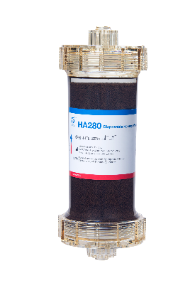
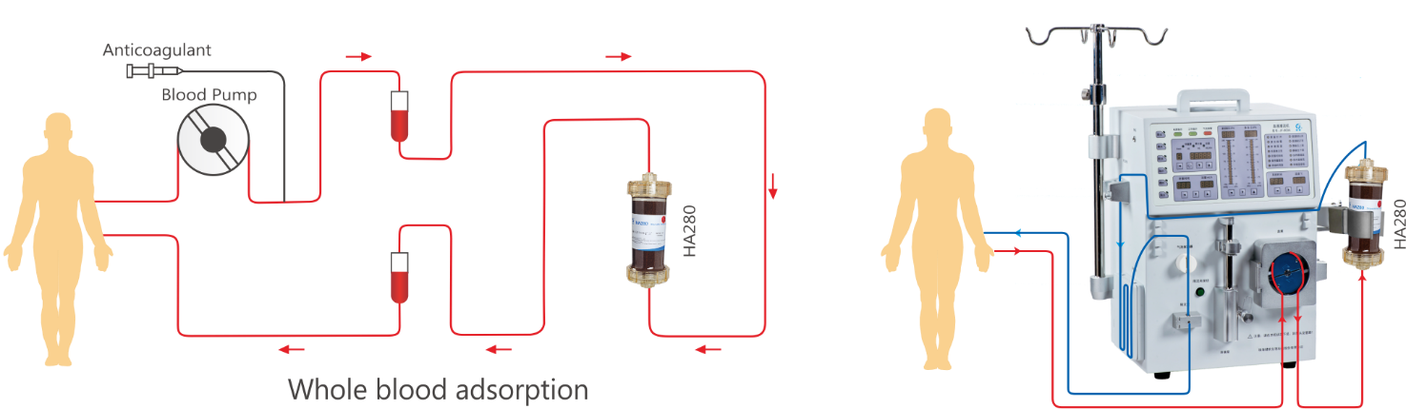
HA280 Disposable Hemoperfusion Cartridge
HA280 can relieve patients from autoimmune disease, specifically removes numerous immune related pathogenic factors and improves prognosis.
Common Treatment Mode of HA280：
Notes:
HA280 can relieve patients from autoimmune disease such as allergic pupura rapidly and effectively, and specifically removes numerous immune related pathogenic factors and improves prognosis.

Slide 38
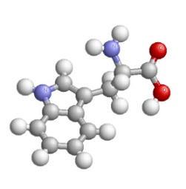
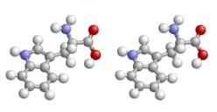
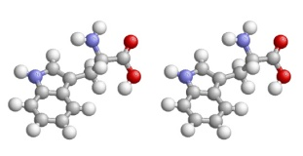
DNA immunoadsorption (IA)
Immunoadsorption therapy refers to the combination of highly specific antigen or antibody or substance with specific physical and chemical affinity (ligand) with adsorbent material (carrier).
Flow Direction
Protein
Ligand
RBC
WBC
Carrier
Platelet
Targeted molecules
Notes:
Immunoadsorption therapy refers to the combination of highly specific antigen or antibody or substance with specific physical and chemical affinity (ligand) with adsorbent material (carrier). When blood or plasmapasses through this adsorbent, it can specifically adsorb the corresponding pathogenic factors in the body and purify the blood.

Slide 39
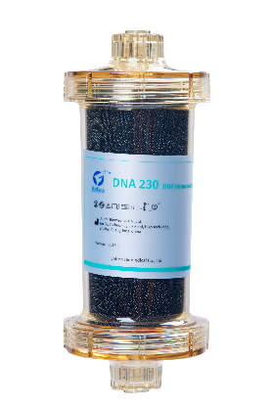
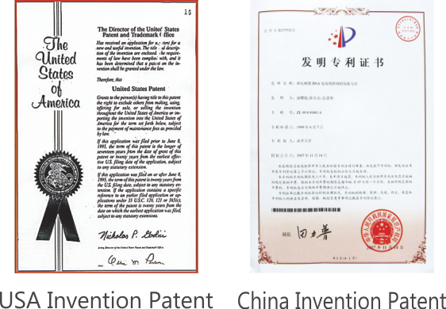
DNA230 Immunoadsorbent Column
DNA230 is especially designed for Systemic Lupus Erythematosus (SLE) and its complications based on the immunoadsorption therapy.
DNA230 can specifically adsorb ANA & anti-ds-DNA antibodies and clear pathogenic immunologic complexes, accordingly ease SLE symptom, protect kidney function, enhance drug sensitivity, reduce the side effect of medicine treatment and improve patients' prognosis.

Slide 40
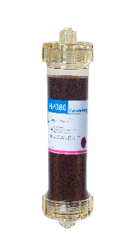
WHY JAFRON PRODUCTS
1. Compatible with all blood purification machines such as hemodialysis machine, CRRT machines, ECMO, CPB
2.Easy to operate and connect and safety issue approved
3.Improve hemodynamic; Benefit organ function;
Reduce the ICU stay; improve survival.
For more details, please log onto the website www.jafron.com to learn about more products.

Slide 41
JAFRONCLUB
@Jafron Biomedical
Scan to register
at jafronclub.com
Scan to watch webinar 2020
at jafron.com
Welcome to join us!

Slide 42
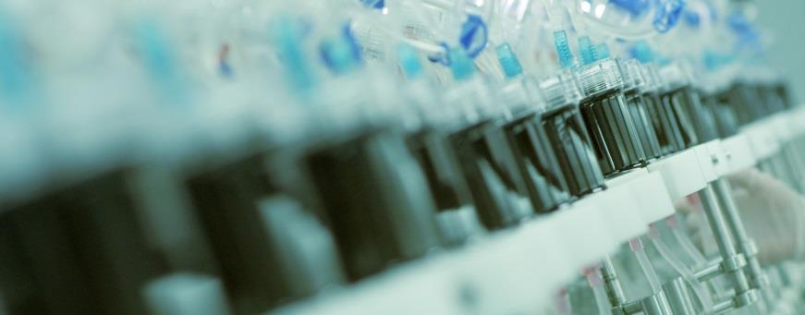
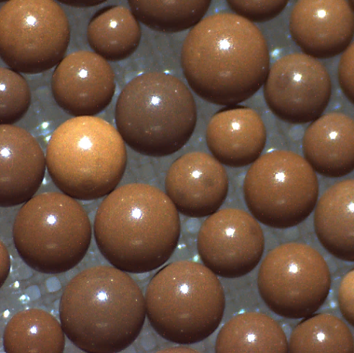
Jafron: make every resin with best quality
Contact Us:
+86 (756) 3689 708
en.jafron.com
support@jafron.com
98, Technology Six Road, High-Tech Zone, 519085, Zhuhai, China

